Slide 1

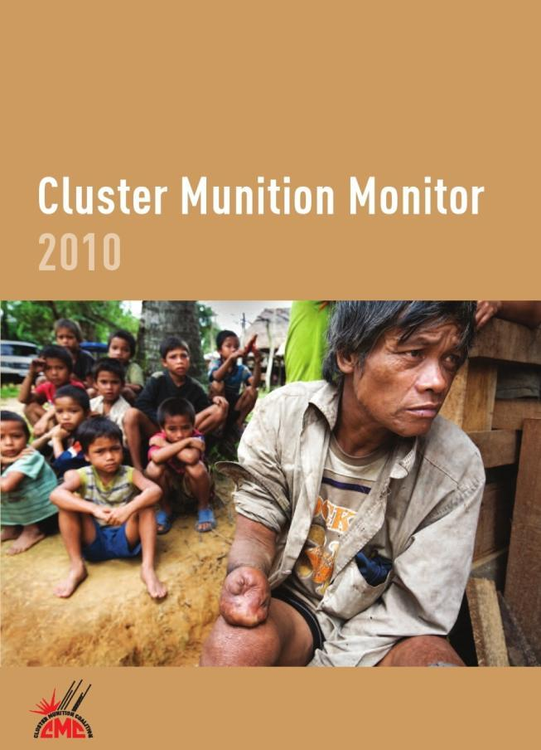
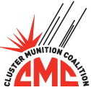
Notes:
Landmine Monitor was created in June 1998 by the Nobel Peace Prize-winning International Campaign to Ban Landmines (ICBL).
In 2008, Landmine Monitor also became the research and monitoring arm of the Cluster Munition Coalition (CMC).
In 2010, the initiative changed its name to Landmine and Cluster Munition Monitor (known as “the Monitor”) to reflect its increased reporting on the cluster munition issue.
Landmine and Cluster Munition Monitor is the de facto monitoring regime for the Mine Ban Treaty and the Convention on Cluster Munitions. It monitors and reports on States Parties’ implementation of, and compliance with, the Mine Ban Treaty and the Convention on Cluster Munitions, and assesses response to the humanitarian problems caused by landmines, cluster munitions, and other explosive remnants of war (ERW). The Monitor represents the first time that NGOs have come together to monitor humanitarian law or disarmament treaties.
This is the first year that the Monitor has published the Cluster Munition Monitor report, the sister publication to the Landmine Monitor report, which has been issued annually since 1999.

Slide 2




Ban Policy
Mine Action
Casualties and Victim Assistance
Support for Mine Action
All countries and seven areas
Notes:
Cluster Munition Monitor 2010 covers global developments in cluster munition ban policy, mine action, casualties and victim assistance, and support for mine action.
It contains information about every country in the world and seven other areas.
The report focuses on the period from May 2009, with information included up to August 2010 when possible.

Slide 3


Convention on Cluster Munitions
Status
Entry into force:
1 August 2010
108 Signatories
43 States Parties
38 former users, producers, exporters, or stockpilers have joined the convention
© Tracie Williams, 1 August 2010
① Persons with disabilities dance to celebrate the Convention on Cluster Munitions entering into force for Lao PDR.
Notes:
Status of the Convention
A total of 108 countries have signed the Convention on Cluster Munitions, including 94 when it opened for signature in December 2008, and 14 afterwards.
Thirty-eight countries that have used, produced, exported, or stockpiled cluster munitions have signed, thereby committing to never engage in those activities again.
After achieving the required 30 ratifications in February 2010, the convention entered into force on 1 August 2010, becoming binding international law.
As of 26 October 2010, a total of 43 signatories had ratified the convention (3 have ratified since Cluster Munition Monitor went to print). Ratifying countries become States Parties fully bound by all the convention’s provisions.
Ten countries have already enacted national legislation to implement the convention.

Slide 4
Convention on Cluster Munitions
Signatories: 108
Signatories that have not yet ratified: 65
Afghanistan | Angola | Australia | Benin
Bolivia | Botswana | Bulgaria | Cameroon
Canada | Central African Rep. | Chad | Chile
Colombia | DRC | Congo, Rep. of the | Cook Islands
Costa Rica | Côte D'Ivoire | Cyprus | Czech Republic
Djibouti | Dominican Rep. | El Salvador | Gambia
Ghana | Guatemala | Guinea | Guinea-Bissau
Haiti | Honduras | Hungary | Iceland
Indonesia | Iraq | Italy | Jamaica
Kenya | Lebanon | Liberia | Liechtenstein
Lithuania | Madagascar | Mauritania | Mozambique
Namibia | Nauru | Netherlands | Nigeria
Palau | Panama | Paraguay | Peru
Philippines | Portugal | Rwanda | Saint Vincent & the Grenadines
Sao Tome & Principe | Senegal | Somalia | South Africa
Sweden | Switzerland | Tanzania | Togo
Uganda
Notes:
Status of the Convention: Signatories
A total of 108 countries have signed the Convention on Cluster Munitions, including 94 when it opened for signature in December 2008, and 14 afterwards.
Thirty-eight countries that have used, produced, exported, or stockpiled cluster munitions have signed, thereby committing to never engage in those activities again. This includes:
seven users (Colombia, France, Iraq, Netherlands, Nigeria, South Africa, and the UK);
five exporters (Chile, France, Germany, Moldova, and the UK);
15 producers (Australia, Belgium, BiH, Chile, France, Germany, Iraq, Italy, Japan, Netherlands, South Africa, Spain, Sweden, Switzerland, and the UK);
and 38 stockpilers.

Slide 5
Convention on Cluster Munitions
Ratifications: 43
Albania | Antigua & Barbuda | Austria | Belgium
Bosnia & Herzegovina | Burkina Faso | Burundi | Cape Verde
Comoros | Croatia | Denmark | Ecuador
Fiji | France | Germany | Holy See
Ireland | Japan | Lao PDR | Lesotho
Luxembourg | Macedonia, FYR | Malawi | Mali
Malta | Mexico | Moldova | Monaco
Montenegro | New Zealand | Nicaragua | Niger
Norway | Samoa | San Marino | Seychelles
Sierra Leone | Slovenia | Spain | Tunisia
United Kingdom | Uruguay | Zambia
Notes:
Status of the Convention: Ratifications
As of 10 September 2010, a total of 40 signatories had ratified the convention. 3 have ratified since Cluster Munition Monitor went to print) Ratifying countries become States Parties fully bound by all the convention’s provisions.
Ten countries have already enacted national legislation to implement the convention.

Slide 6
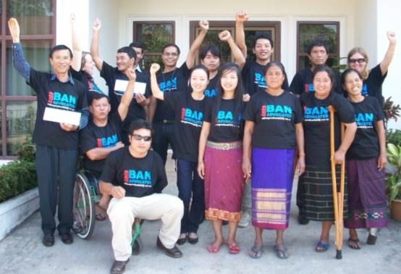
Cluster Munition
Use
Cluster munitions have been used over the past 6 decades:
  by 18 governments
  in 39 states and areas
Since the Convention on Cluster Munitions opened for signature in December 2008, only 1 serious allegation of use
②Cluster munition survivors attend an advocacy training workshop in Vientiane, Lao PDR.
© Stephanie Castanie, HI, January 2010
Notes:
Use
Cluster munitions have been used during armed conflict in 39 countries and disputed territories since the end of World War II. At least 18 government armed forces have used cluster munitions.
Since the Convention on Cluster Munitions was opened for signature in December 2008, there has been only one serious allegation of use of the weapon. Amnesty International reported that the United States appeared to have used at least one cruise missile with submunitions to attack an alleged al-Qaeda training camp in Yemen in December 2009.
Countries where cluster munitions have been used: Afghanistan, Albania, Angola, Azerbaijan, BiH, Cambodia, Chad, Colombia, Croatia, DRC, Eritrea, Ethiopia, Georgia, Grenada, Iran, Iraq, Israel, Kuwait, Lao PDR, Lebanon, Libya, Mauritania, Montenegro, Mozambique, Russia (Chechnya), Saudi Arabia, Serbia, Sierra Leone, Sudan, Syria, Tajikistan, Uganda, Vietnam, Yemen, and Zambia, as well as the Falkland Islands/Malvinas, Kosovo, Nagorno-Karabakh, and Western Sahara.
Governments that have used cluster munitions: Colombia, Eritrea, Ethiopia, France, Georgia, Iraq, Israel, Libya, Morocco, Netherlands, Nigeria, Russia, Saudi Arabia, South Africa, Sudan, UK, US, Yugoslavia (former Socialist Republic of).

Slide 7
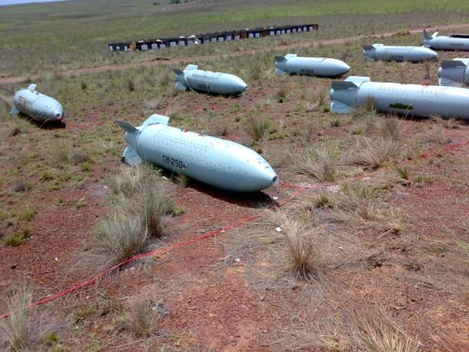
Cluster Munition
Stockpiling
86 stockpilers before ban movement
74 current stockpilers – including 27 that have joined the convention
17 States Parties or signatories have declared stockpiles totaling:
© Angela Sanabria, CCCM, 7 May 2010
① Destruction of Colombia’s last stockpiled cluster munitions.
    1.1 million cluster munitions
    146 million submunitions
Notes:
Stockpiling:
The Monitor estimates that prior to the start of the global effort to ban cluster munitions, 86 countries stockpiled millions of cluster munitions containing more than one billion submunitions.
Currently, 74 nations have cluster munition stockpiles. Of those, 27 have signed and/or ratified the Convention on Cluster Munitions.
Seventeen states that have signed and/or ratified have provided information about the size of their stockpile. Collectively, prior to any destruction activities, they possessed at least 1.1 million cluster munitions with at least 146 million submunitions.

Slide 8
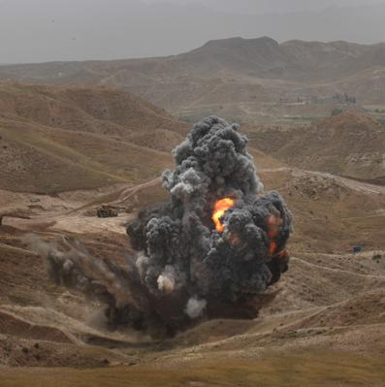
Cluster Munition
Stockpile Destruction
7 States Parties and signatories have destroyed stockpiles totalling:
  176,000 cluster munitions
  13.8 million submunitions
11 states are currently destroying stocks
© Sean Sutton, MAG, May 2010
① Destroying munitions in Iraq.
Notes:
Stockpile Destruction:
Five States Parties (Belgium, Moldova, Montenegro, Norway, and Spain) and two signatories (Colombia and Portugal) have already completed destruction of their stockpiles of cluster munitions. Collectively, they destroyed about 176,000 cluster munitions with more than 13.8 million submunitions.
In addition, signatories Afghanistan and Angola reported in 2010 that their cluster munition stocks had been destroyed in recent years as part of broader weapons disposal programs.
Austria expects to finish stockpile destruction in 2010. Two of the biggest stockpilers, Germany (50 million submunitions) and the United Kingdom (39 million submunitions) have destroyed significant portions of stocks. At least another eight countries are in the process of destroying stocks.

Slide 9
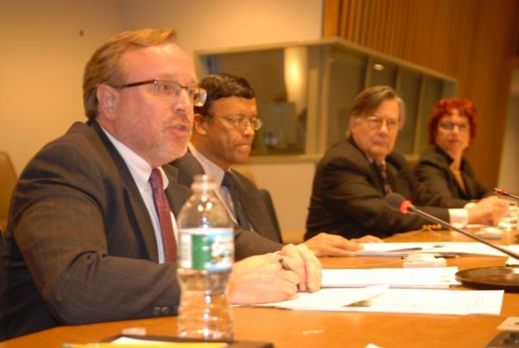
Cluster Munition
Retention
Most stockpilers have chosen not to retain any cluster munitions and/or submunitions for training and development
Belgium, France, and Spain intend to keep:
  hundreds of cluster munitions
  over 20,000 submunitions
© Mary Wareham, HRW, October 2009
① Special event on the Convention on Cluster Munitions organized by the CMC at the UN in New York.
Notes:
Retention:
Although the convention permits the retention of some cluster munitions and submunitions for training and development purposes, most stockpilers thus far have chosen not to retain any, including Afghanistan, Angola, Austria, Colombia, Honduras, Moldova, Montenegro, Norway, Portugal, and Slovenia.
Belgium, France, and Spain have indicated they each intend to keep hundreds of cluster munitions and more than 20,000 submunitions.

Slide 10
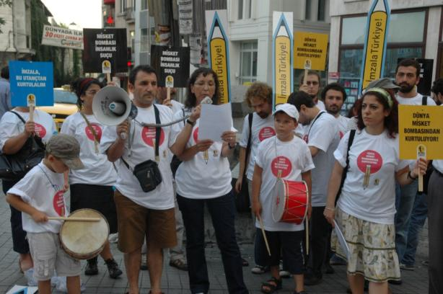
Cluster Munition
Production
②Turkish campaigners call on their government to join the convention.
34 states have developed or produced cluster munitions
15 former producers have signed or ratified the convention
© IMFT, August 2010
17 countries continue to produce, or reserve the right to produce cluster munitions
Notes:
Production
A total of 34 states have developed or produced more than 200 types of cluster munitions.
Fifteen former producers of cluster munitions have signed and/or ratified the Convention on Cluster Munitions, thereby foreswearing any future production.
Seventeen countries continue to produce cluster munitions, or reserve the right to produce in the future.
Fifteen of these states signed the Convention on Cluster Munitions, foreswearing any future production. Argentina and Serbia have indicated that they do not intend to produce in the future.

Slide 11
Cluster Munition
Production
Countries that have developed or produced cluster munitions
States Parties and Signatories |  | Non-Signatories
Australia | Japan | Argentina | Pakistan
Belgium | Netherlands | Brazil | Poland
BiH | South Africa | China | Romania
Chile | Spain | Egypt | Russia
France | Sweden | Greece | Serbia
Germany | Switzerland | India | Singapore
Iraq | UK | Iran | Slovakia
Italy |  | Israel | Turkey
 |  | North Korea | US
 |  | South Korea
Note: Italics indicate non-signatories that say they no longer produce.
Notes:
Production
A total of 34 states have developed or produced more than 200 types of cluster munitions.
Fifteen former producers of cluster munitions have signed and/or ratified the Convention on Cluster Munitions, thereby foreswearing any future production.
Seventeen countries continue to produce cluster munitions, or reserve the right to produce in the future.
Fifteen of these states signed the Convention on Cluster Munitions, foreswearing any future production. Argentina and Serbia have indicated that they do not intend to produce in the future.

Slide 12



Cluster Munition
Transfer
⧫ Students in the US begin a 100 day countdown to entry into force of the Convention on Cluster Munitions.
© Nora Sheets, WVCBL/PSALM, May 2010
No reported transfer of cluster munitions in 2009 or the first half of 2010
Two states not party have a moratorium on exports of cluster munitions: Singapore & the United States
Notes:
Transfer
There were no reported transfers of cluster munitions in 2009 or the first half of 2010, other than inert components transferred from South Korea to Pakistan.
Two states not party to the convention, Singapore and the US, have instituted a moratorium on exports of cluster munitions.

Slide 13
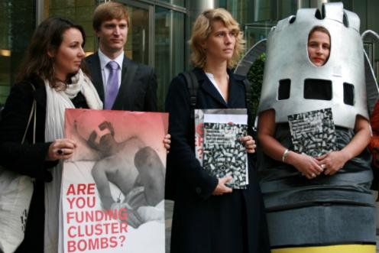
Cluster Munition
Interpretive Issues
“Interoperability”
  Addressed in Article 21 of the convention
Transit & foreign stockpiling
Disinvestment
© Jeppe Schilder, IKV Pax Christi, 29 October 2009
  Financial institutions have taken action to stop investment in at least 13 states
  16 states have said investment in production is prohibited
① Campaigners publicize a report on cluster munition investments outside a bank in London.
Notes:
Assistance with Prohibited Acts
In negotiations, some states expressed concern about the possible impact of the Article 1 prohibition on assistance on joint military operations with countries that have not joined the convention. In response to these “interoperability” concerns, states agreed to the insertion of a new Article 21 on “Relations with States not Party to this Convention.” This article was strongly criticized by the CMC for being politically motivated and for leaving a degree of ambiguity about how the prohibition on assistance would be applied in joint military operations.
Most states that have expressed a view have indicated that, even during joint operations, any intentional or deliberate assistance is prohibited: Colombia, Ecuador, Ghana, Guatemala, Iceland, Lebanon, Madagascar, Malawi, Mexico, Norway, and Slovenia.
Transit
The CMC has stated that the ban on transfer and assistance with prohibited acts in Article 1 of the convention should be seen as a ban on the transit of cluster munitions across or through the territory, airspace, or waters of a State Party. It has also said that the ban on stockpiling and the ban on assistance should be seen as prohibiting the stockpiling of cluster munitions by a state not party on the territory of a State Party.
Most states that have expressed a view have indicated that the transit of cluster munitions by a state not party across the territory of a State Party is prohibited: Austria, Bulgaria, Burkina Faso, Colombia, Ecuador, Ghana, Guatemala, Lebanon, FYR Macedonia, Madagascar, Malawi, Malta, Mexico, Slovenia, South Africa, and Zambia.
Disinvestment
There has been a great deal of activity on the part of NGOs and financial institutions aimed at disinvestment from producers of cluster munitions. The CMC has taken the position that the convention’s prohibition on assistance with prohibited acts constitutes a prohibition on investment, direct and indirect, in production of cluster munitions.
Financial institutions and investors have taken action to stop investment in cluster munition production in Argentina, Belgium, Canada, Denmark, France, Germany, Japan, Netherlands, New Zealand, Norway, Sweden, Switzerland, the UK, and elsewhere.
Many states have expressed the view that investment in cluster munition production is prohibited: Belgium, Colombia, France, Guatemala, Ireland, Lebanon, Luxembourg, Madagascar, Malawi, Malta, Mexico, New Zealand, Norway, Rwanda, the UK, and Zambia.

Slide 14
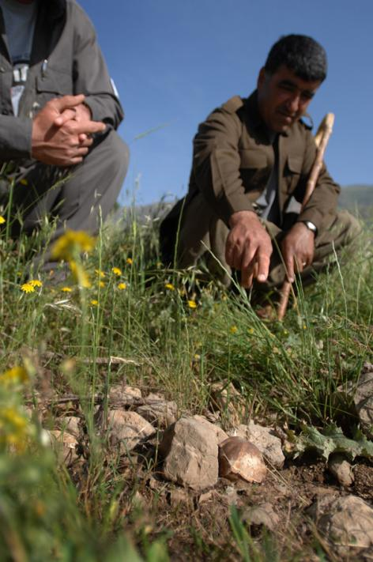
Cluster Munition
Contamination
At least 23 states/3 areas are currently contaminated
including 5 states that have joined the convention
Most contaminated regions:
Southeast Asia & Europe
Heavily affected states/areas include: Cambodia, Iraq, Lao PDR, Lebanon, Serbia, Vietnam, Nagorno-Karabakh & Western Sahara
© Sean Sutton, MAG, May 2010
① A community-member identifies an unexploded submunition in Iraq.
Notes:
Contamination
At least 23 states and three other areas are believed to be currently contaminated with cluster munition remnants.
Thirteen or more additional states may still have a small level of contamination from past use of the weapon.
Southeast Asia is by far the region with the greatest amount of cluster munition contamination, followed by Europe.
The most heavily affected countries include Lao PDR, Vietnam, Iraq, and Cambodia. Others with a serious problem include Lebanon and Serbia, as well as the disputed areas of Nagorno-Karabakh and Western Sahara.
Of the 42 states that have ratified the Convention on Cluster Munitions, at least five are believed to be contaminated: Bosnia and Herzegovina, Croatia, Lao PDR, Montenegro, and the UK (Falkland Islands/Malvinas). The clearance deadline for Croatia, Lao PDR, and Montenegro is 1 August 2020, for the UK is 1 November 2020, and for Bosnia and Herzegovina is 1 March 2021.

Slide 15
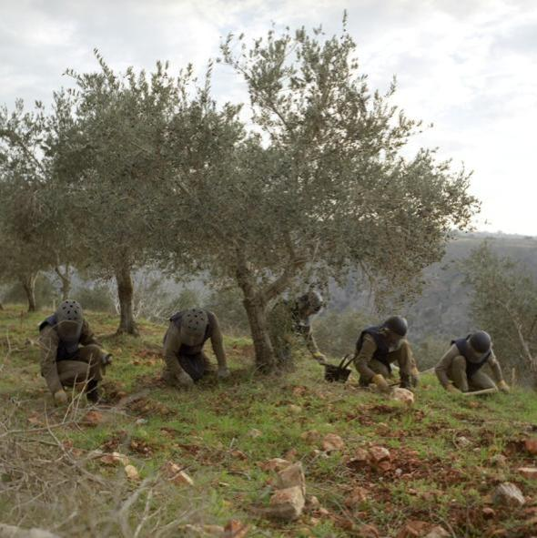
Cluster Munition
Clearance
At least 38 km² of land was cleared in 2009, with more than 55,156 unexploded submunitions destroyed
States Parties Albania & Zambia announced completion of clearance in 2009 and early 2010
© Alison Locke, 2006
① Clearance in southern Lebanon.
Clearance/survey in only 14 states/3 areas in 2009
Notes:
Clearance
At least 38 km² of land was cleared of cluster munition remnants in 2009, with more than 55,156 unexploded submunitions destroyed.
States Parties Albania and Zambia announced completion of their clearance programs in November 2009 and May 2010, respectively.
In 2009, there was clearance of unexploded submunitions or some form of survey of the problem in just 14 countries and three other areas. In many cases, these activities were very limited.
Of the nine countries with no reported survey or clearance activities related to unexploded submunitions in 2009, two are States Parties (Croatia and Montenegro) and four are signatories (Chad, Iraq, Mauritania, and the Republic of the Congo).

Slide 16
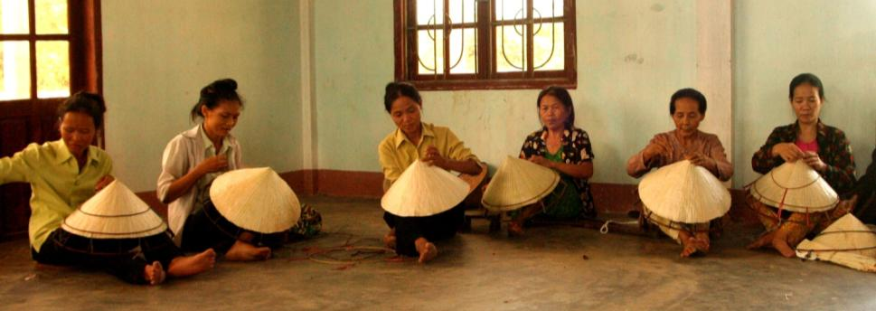
Cluster Munition
Casualties
⧫ Survivors in Vietnam participate in the Conical Hat Business Group, making hats to be sold throughout Vietnam and Lao PDR.
▪
© Gretchen Murphy, 2009 Peace Fellow, The Advocacy Project, 21 July 2009
Cluster munition casualties have been recorded in at least 27 states and areas, including:
  6 States Parties to the convention, and
  9 Signatories
Notes:
Casualties
Cluster munition casualties have been recorded in at least 27 states and three other areas affected by cluster munitions.
Of the 27 states, six are States Parties to the Convention on Cluster Munitions (Albania, Bosnia and Herzegovina, Croatia, Lao PDR, Montenegro, and Sierra Leone) and nine are signatories (Afghanistan, Angola, Chad, DRC, Guinea-Bissau, Iraq, Lebanon, Mozambique, and Uganda).

Slide 17
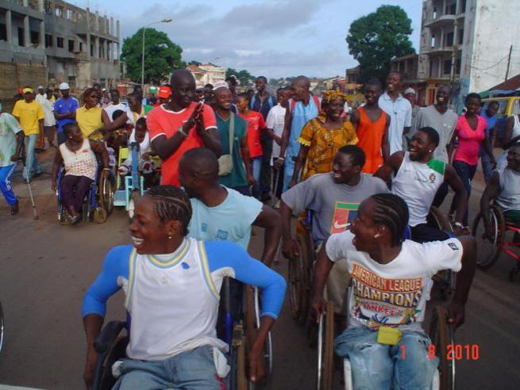
Cluster Munition
Casualties
16,816 cluster munition casualties confirmed globally by end of 2009
Actual number is at least 58,000-85,000
100 confirmed cluster munition casualties in 9 countries and 1 area in 2009
© Etchen Sambu, 1 August 2010
① A march through the streets of Bissau celebrates the convention’s entry into force in Guinea-Bissau.
Notes:
Casualties
There were 16,816 cluster munition casualties confirmed globally as of the end of 2009. However, many casualties have gone unrecorded and it is likely that the actual number of casualties is at least between 58,000 and 85,000.
There were 100 confirmed cluster munition casualties in nine countries and one area in 2009, including 33 in Lao PDR. It is likely the actual number is considerably higher.

Slide 18
Cluster Munition Casualties
States/Areas with Casualties: 27
Africa | Asia-Pacific | Europe-CIS | Middle East-North Africa
Angola | Afghanistan | Albania | Iraq
Chad | Cambodia | Bosnia and Herzegovina (BiH) | Israel
DRC | Lao PDR | Croatia | Kuwait
Eritrea | Vietnam | Georgia | Lebanon
Ethiopia |  | Montenegro | Syria
Guinea-Bissau |  | Russia | Western Sahara
Mozambique |  | Serbia
Sierra Leone |  | Tajikistan
Sudan |  | Kosovo
Uganda |  | Nagorno-Karabakh
Note: Other areas are indicated by italics. Black text indicates the 5 states with the largest numbers of casualties.

Slide 19
Cluster Munition Casualties
States with Reported Casualties in 2009: 10
State/area | Casualties | Convention status
Afghanistan | 3 | Signatory
BiH | 3 | State Party
Cambodia | 10 | State not party
DRC | 10 | Signatory
Iraq | 1 | Signatory
Lao PDR | 33 | State Party
Lebanon | 17 | Signatory
Sudan | 14 | State not party
Vietnam | 7 | State not party
Kosovo | 2 | Not applicable
Total | 100
Note: Other areas are indicated by italics.

Slide 20

Cluster Munition
Victim Assistance
Cluster munition victims include the person directly impacted, their families, and communities
All 27 states with survivors have assistance programs in place
Most states face challenges
© P. Grappin, HI, 26 September 2009
① Awareness-raising event in France, with a shoe pile symbolizing the lives lost to cluster munitions.
providing assistance, in particular: economic inclusion and psychosocial support
Notes:
Victim Assistance
According to the Convention on Cluster Munitions, cluster munition victims are defined as all persons who have been killed or suffered physical or psychological injury, economic loss, social marginalization, or substantial impairment of the realization of their rights caused by the use of cluster munitions. Cluster munition victims include those persons directly impacted by cluster munitions as well as their affected families and communities.
All of the 27 states with cluster munition victims have some type of assistance program already in place. Twenty of the 27 are party to the Mine Ban Treaty and have developed victim assistance programs in that context.
However, nearly every state with cluster munition victims faces significant challenges providing holistic and accessible care to affected individuals, families, and communities. Particularly notable are the lack of economic inclusion and psychosocial support, and insufficient availability or access to services for those in rural areas.

Slide 21
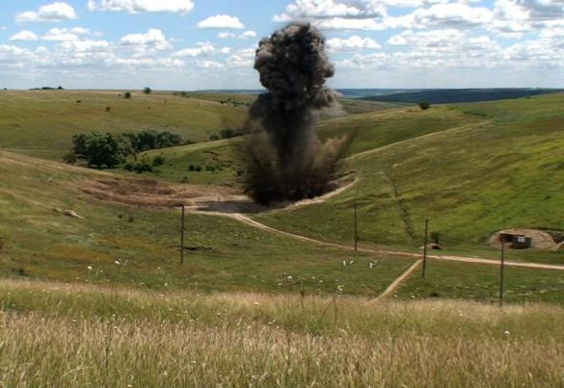
Cluster Munition
Support for Mine Action
In 2009, 7 states reported US$13.2 million in spending related to cluster muntions, including via the Cluster Munitions Trust Fund for Lao PDR
In 2009, donor contributions related to cluster munitions focused on universalization of the convention, clearance, and stockpile destruction
© Asle Huse, NPA, 29 July 2010
① Moldova completes its stockpile destruction in July 2010.
Notes:
Support for Mine Action
Only a relatively small number of states reported funding specifically related to cluster munitions or the Convention on Cluster Munitions. Seven states reported a combined total of US$13.2 million, spent on universalization, preparations for the First Meeting of States Parties (including via the Cluster Munitions Trust Fund for Lao PDR), clearance, victim assistance, stockpile destruction, and advocacy.
Many others spent funds, particularly for universalization and destruction of their own stocks, but did not report amounts. Funding for clearance in Lao PDR, Lebanon, and Vietnam was utilized in large part for clearance of unexploded submunitions.
The Cluster Munitions Trust Fund for Lao PDR was established in March 2010, and had received $4.15 million in contributions from four nations as of early September 2010, according to UNDP.
In order to meet their obligations under the Convention on Cluster Munitions, States Parties can request assistance from the international community to support stockpile destruction, clearance, risk education, and victim assistance activities. States Parties in a position to do so are obligated to provide such assistance.
In 2009, cluster munition-specific donor contributions were focused on activities promoting the universalization of the Convention on Cluster Munitions and on clearing cluster munition remnants in Lao PDR, Lebanon, and Vietnam, three of the most affected countries. Two donors contributed to stockpile destruction in Moldova, and numerous states spent funds destroying their own stocks of cluster munitions.

Slide 22
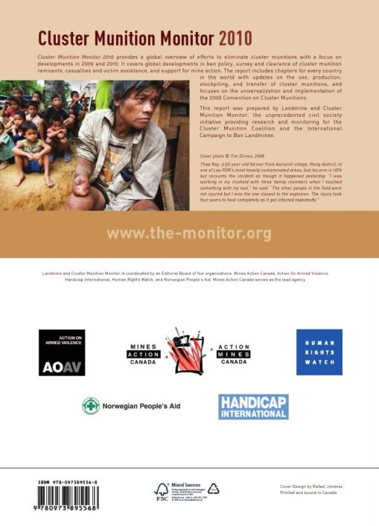
Thank you
monitor@icbl.org
www.the-monitor.org
Notes:
Cluster Munition Monitor is available for download or to view online at: www.the-monitor.org
Full Country Profiles are available online at: www.the-monitor.org/cp

