Slide 1
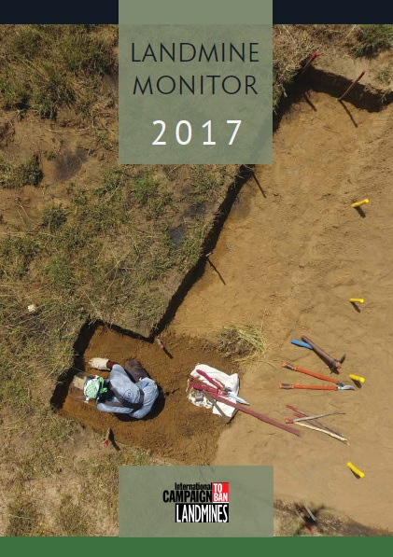
Full excavation by a female deminer in Sri Lanka with mineline shown by yellow sticks.
© Helaine Boyd/HALO Trust, May 2017
Notes:
Pictured here is a female deminer conducting clearance in Sri Lanka. Now 20 years since the Mine Ban Treaty first opened for signature and the 19th edition of the annual Landmine Monitor, the image suggests the hard work and persistence that is still needed, especially to reach the goal of a mine free 2025. At the same time, it is encouraging evidence of the successes achieved thus far.

Slide 2
Main Sections of the Report
Landmine Ban Policy
Contamination and Clearance
Casualties
Victim Assistance
Support for Mine Action
Notes:
Landmine Monitor 2017 provides a global overview of efforts in 2016, and into November 2017 where possible, to universalize and fully implement the 1997 Mine Ban Treaty, and more generally assess the international community’s response to the global landmine and explosive remnants of war problem. It covers developments in the areas of antipersonnel landmine use, production, stockpiling, mine action, casualties, victim assistance, and mine action funding.
This presentation generally follows the order of these sections, highlighting the Major Findings of the report.

Slide 3
Landmine Monitor 2017 overview
Global ban endures; landmines used by very few government forces—all outside the Treaty—and by non-state actors in at least 9 countries.
Casualties at exceptionally high levels for second year in a row.
Support for mine action has risen from 2015.
Clearance continues, additional states have declared completion of clearance, however only a few countries are on track.
Notes:
A small number of states and non-state armed groups use antipersonnel mines, including improvised mines, which contributed to a very high number of casualties recorded in 2016.
Many countries continue to clear mine contamination, and international funding for mine action increased in 2016.
However, very few States Parties appear to be on track to meet clearance deadlines, and support to victims remains inadequate.

Slide 4
A total of 162 States Parties are implementing the treaty’s provisions.
The 35 countries that remain outside of the treaty are nonetheless abiding by its key provisions.
Notes:
Twenty years after the Mine Ban Treaty was negotiated and signed, it continues to be a tremendous life-saving success.
There were no new ratifications or accessions in the reporting period. Of the 162 States Parties, 132 signed and ratified the treaty, while 30 acceded. The last country to accede to the Mine Ban Treaty was Oman on 20 August 2014.

Slide 5
Landmine Use
Use of antipersonnel mines by states remains rare.
No confirmed new use of the weapons by States Parties during October 2016 – October 2017.
Government forces in states not party Myanmar and Syria used antipersonnel landmines in the past year.
Non-state armed groups used antipersonnel landmines, including improvised mines, in at least 9 countries.
Notes:
Landmine Monitor has confirmed new use of antipersonnel mines by the government forces of Myanmar and Syria, neither of which are party to the Mine Ban Treaty. There was no new use of antipersonnel mines in Colombia for the first time since the Monitor began
publishing in 1999.
Antipersonnel mines have been used by government forces of Myanmar throughout the past 20 years and by government forces of Syria since 2012. According to eyewitness accounts, photographic evidence, and multiple reports, antipersonnel mines have been laid between Myanmar’s two major land crossings with Bangladesh, resulting in casualties among Rohingya refugees fleeing government attacks on their homes. The mine use began in late August 2017, when Myanmar government forces began operations against the Rohingya population, causing the flight of more than 600,000 people to neighboring Bangladesh. It is unclear if this mine use has continued as parts of the border area remain inaccessible.
Non-state armed groups (NSAGs) used antipersonnel mines in at least nine countries, Afghanistan, India, Iraq, Myanmar,
Nigeria, Pakistan, Syria, Ukraine, and Yemen.
The extensive use of improvised mines by the Islamic State has resulted in new casualties and contamination.

Slide 6
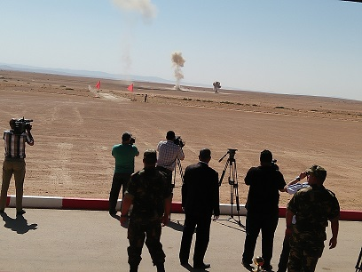
Stockpile Destruction, Production, Transfer
More than 2.2 million stockpiled mines destroyed in 2016; Belarus finished in 2017.
86 states do not retain any mines; Algeria destroyed last retained mines.
41 states have ceased production.
Some illicit transfers continue: Ukraine, Yemen.
Destruction of the last retained antipersonnel mines in Algeria on 18 September 2017. © Youcef Rafai/ICBL, Sept 2017
Notes:
Collectively, States Parties have destroyed more than 53 million stockpiled antipersonnel mines, including more than 2.2 million destroyed in 2016.
Belarus completed the destruction of its stockpiles in April 2017 after being in violation of the convention since 2008.
Algeria destroyed 5,970 antipersonnel mines retained for training purposes after completing its landmine clearance program.
In 1999, states stockpiled about 160 million antipersonnel mines, but today the global total may be less than 50 million
41 states ceased production of antipersonnel mines. Four that are not party to the Mine Ban Treaty include: Egypt, Israel, Nepal, and the US.
The use of factory-produced antipersonnel mines in conflicts in Ukraine and Yemen, where declared stockpiles had been destroyed, indicates that some transfers, either internally among actors or from sources external to the country, are occurring.
At least nine states not party to the Mine Ban Treaty have formal moratoriums on the export of antipersonnel mines: China, India, Israel, Kazakhstan, Pakistan, Russia, Singapore, South Korea, and the US.
In February 2017, the Egyptian Ministry of Military Production advertised “Heliopolis plastic antipersonnel landmines” for sale at its display at the IDEX arms fair in Abu Dhabi. Egyptian authorities did not respond to a June 2017 request by the Monitor for further information regarding the apparent change in policy on export, and possibly production.

Slide 7
TREATY COMPLIANCE
Ukraine, is in violation of Article 5 of the Mine Ban Treaty due to missing its 1 June 2016 clearance deadline without having requested and being granted an extension.
Greece and Ukraine have missed their deadlines to complete stockpile destruction.
Only 48% of States Parties submitted transparency reports for 2016.
37 States Parties retain more than 1000 mines.
Notes:
One state, Ukraine, is in violation of Article 5 of the Mine Ban Treaty due to missing its 1 June 2016 clearance deadline without having requested and being granted an extension.
Yemen previously confirmed that its forces violated the treaty by using antipersonnel mines in 2011. As of November 2017, investigations were still pending.
Greece and Ukraine have missed their deadlines to complete stockpile destruction. Ukraine has 4.9 million antipersonnel mines remaining to be destroyed, while Greece has 643,267.
Only 48% of States Parties have submitted annual reports for calendar year 2016, a slight increase from the previous year (45%). A total of 83 States Parties have not submitted a report for calendar year 2016. Only one State Party has not submitted an initial report: Tuvalu (due 28 August 2012).
A total of 71 States Parties have reported that they retain antipersonnel mines for training and research purposes, of which 37 retain more than 1,000 mines. Finland, Turkey, and Bangladesh each retain more than 12,000 mines.

Slide 8
61 states and areas have an identified threat of antipersonnel mine contamination:
33 States Parties
24 states not party
four other areas
Notes:
The Monitor acknowledges the contributions of Mine Action which has conducted the mine action research in 2017, including on survey and clearance, and shared all its resulting landmine and cluster munition reports with the Monitor.
Changes to these figures will be discussed in subsequent slides.

Slide 9
Contamination
New contamination in 2016 and 2017, much of which consisted of improvised mine contamination, was reported in the following States Parties: Afghanistan, Iraq, Nigeria, Ukraine, and Yemen; and in states not party: India, Libya, Myanmar, North Korea, Pakistan, and Syria.
Massive antipersonnel mine contamination (>100 km² per country) believed to exist in Afghanistan, Angola, Azerbaijan, Bosnia and Herzegovina, Cambodia, Chad, Croatia, Iraq, Thailand, and Turkey.
Notes:
The global picture did not change considerably in 2016, although a number of countries, particularly States Parties, have continued to improve their knowledge of the extent of their contamination through the increased use of land release methodologies, to cancel suspected hazardous areas by nontechnical survey, and to reduce confirmed hazardous areas through technical survey.
Sixty-one states and areas are contaminated by antipersonnel mines as of November 2017.
This includes 33 States Parties to the Mine Ban Treaty, 24 states not party, and four other areas.
Ten States Parties have residual or suspected contamination: Algeria, Cameroon, Djibouti, Kuwait, Mali, Moldova, Namibia, Palau, the Philippines, and Tunisia.
Massive antipersonnel mine contamination (more than 100 km2 total per country) is believed to exist in Afghanistan, Angola, Azerbaijan, Bosnia and Herzegovina, Cambodia, Chad, Croatia, Iraq, Thailand, and Turkey
New contamination in 2016 and 2017, much of which consisted of improvised mine contamination, was reported in the following States Parties: Afghanistan, Iraq, Nigeria, Ukraine, and Yemen; and in states not party: India, Libya, Myanmar, North Korea, Pakistan, and Syria. All of these states already had contamination from previous years.
There were unconfirmed reports of new antipersonnel mine contamination in Cameroon, Chad, Iran, Mali, Niger, Philippines, Saudi Arabia, and Tunisia.

Slide 10
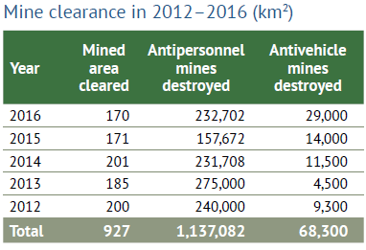
Clearance
Algeria and Mozambique (re)declared completion of clearance in 2017.
About 170 km² reported cleared in 2016.
232,000 antipersonnel mines, 29,000 antivehicle mines were destroyed in 2016.
Ukraine is in violation of Article 5 of the Mine Ban Treaty.
Only 4 State Parties are on track to meet their clearance deadlines.
Notes:
Algeria declared completion of clearance in February 2017. Mozambique, which had declared completion in 2015 but subsequently found previously unidentified antipersonnel mine contamination in 2016 and 2017, completed clearance in May 2017.
In 2016, more than 232,000 antipersonnel mines and some 29,000 antivehicle mines were destroyed. This represented a significant increase from 2015 results.
Ukraine, is in violation of Article 5 of the Mine Ban Treaty due to missing its 1 June 2016 clearance deadline without having requested and being granted an extension.
Only 4 State parties on track to meet their clearance deadlines: Chile, Democratic Republic of the Congo, Mauritania, and Peru
Five States Parties requested extended deadlines for approval at the Sixteenth Meeting of States Parties in December 2017: Angola, Ecuador, Iraq, Thailand, and Zimbabwe.

Slide 11
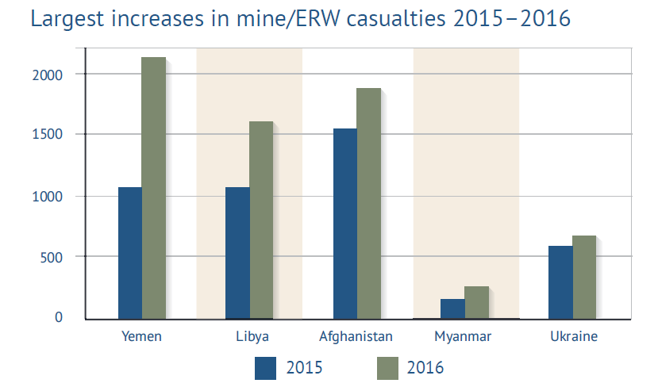
Casualties
The Monitor recorded 8,605 mine/ERW casualties, of which at least 2,089 people were killed, in 2016.
The high total was mostly due to casualties recorded in armed conflicts in Afghanistan, Libya, Ukraine, and Yemen
Notes:
2016 was the second year in a row with exceptionally high numbers of people recorded as killed or injured by landmines
The high total was mostly due to casualties recorded in armed conflicts in Afghanistan, Libya, Ukraine, and Yemen. Accurate data gathering for active conflicts, however, remains challenging.
Declining casualty rates were recorded in Cambodia and Colombia in 2016, two States Parties that in the past were among those with the highest number of casualties.

Slide 12
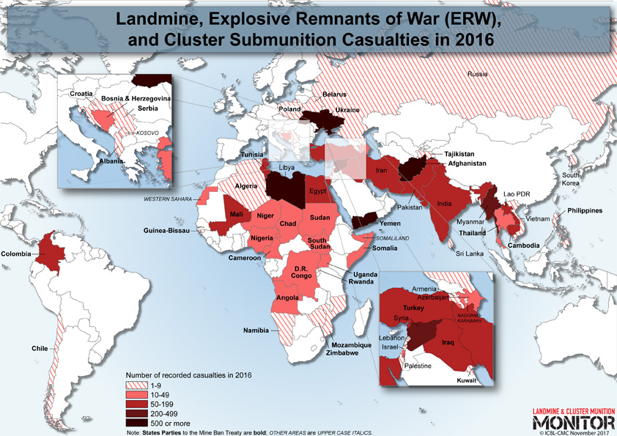
Casualties were identified in 52 states and four other areas in 2016, of which 35 are States Parties to the Mine Ban Treaty.
Notes:
In 2016 and 2017, large quantities of improvised mine contamination and/or numerous incidents and casualties were reported in the following States Parties: Afghanistan, Chad, Colombia, Iraq, Niger, Nigeria, Ukraine, and Yemen.

Slide 13
Casualties in Detail
2016 marked highest number of annual recorded casualties in Monitor data since 1999 (9,228), the most child casualties ever recorded, highest number of annual casualties caused by improvised mines.
The vast majority of recorded landmine/ERW casualties were civilians (78%) where their status was known, which is similar to the past three years.
Children accounted for 42% of all civilian casualties.
Women and girls made up 16% of all casualties where sex known.
Notes:
2016 marked the highest number of annual recorded casualties in Monitor data since 1999 (9,228), the most child casualties ever recorded, and the highest number of annual casualties caused by improvised mines.
children accounted for 42% of all civilian casualties
Women and girls made up 16% of all casualties

Slide 14
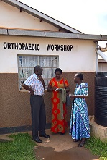
Victim Assistance
In 2016–2017, most States Parties to the Mine Ban Treaty with significant numbers of mine victims suffered from a lack of adequate resources to fulfill the commitments of the 2014– 2019 Maputo Action Plan.
States Parties still need to demonstrate what they are doing to increase the capacity of survivors’ organizations.
Margaret Arach Orech asks about prostheses at the Gulu Regional Orthopaedic workshop, Uganda.
© Loren Persi Vicentic/ICBL-CMC, July 2017
Notes:
In 2016–2017, most States Parties to the Mine Ban Treaty with significant numbers of mine victims suffered from a lack of adequate resources to fulfill the commitments of the 2014–2019 Maputo Action Plan. Findings below relate to the 31 States Parties with significant numbers of mine victims.
Although approximately two-thirds of the States Parties had active coordination mechanisms, survivors’ representatives participated in just 17 of the coordinating processes among those 20 States Parties; even then this often did not result in their contributions being taken into account. (There appears to be a slow degradation in coordination and participation.)
States Parties still need to demonstrate what they are doing to increase the capacity of survivors’ organizations and to enhance their meaningful participation in all relevant matters.
In many states and regions, facilities providing rehabilitation services were limited, were often not available in all remote areas where needed, and sometimes prohibitively expensive. However, construction of several much-needed prosthetics centers was reported in 2016–2017.
Access to employment, training, and other income-generation support activities was reduced noticeably in many of the States Parties over the past few years, leaving significant gaps where opportunities for livelihoods were most needed.

Slide 15
Support for Mine Action: overview
Donors and affected states contributed approximately US$564.5 million in international and national support for mine action in 2016, a 7% increase.
32 donors contributed $479.5 million in international support for mine action to 40 states and three other areas; an increase of $85.5 million (22%).
11 affected states reported providing $85.0 million in national support for their own mine action programs, decrease of $46.2 million (35%).
Notes:
Donors and affected states contributed approximately US$564.5 million in international and national support for mine action in 2016, an increase of $39.3 million (7%) from 2015.
Thirty-two donors contributed $479.5 million in international support for mine action to 40 states and three other areas. This represents an increase of almost $85.5 million (22%) from 2015.
Eleven affected states reported providing $85.0 million in national support for their own mine action programs, a decrease of $46.2 (35%) million compared with 2015. More than $35 million of this decrease occurred in one country, Angola.

Slide 16
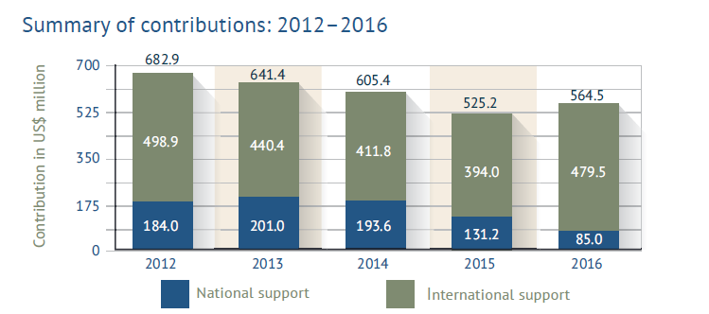
Notes:
After three years of declining support (a 26% decrease between 2012 and 2015), total international support provided in 2016 represents the third-highest level of the past decade—after the $498.9 million provided in 2012, and the $480.4 million in 2010.
The top five mine action donors—the United States (US), the European Union (EU), Japan, Germany, and Norway—contributed 70% of all international funding, with a combined total of $335.6 million.
Twenty donors increased their funding in 2016, with the EU and Germany accounting for $55 million (64%) of the global increase.
The top five recipient states—Iraq, Afghanistan, Croatia, Cambodia, and Lao PDR—received $258.7 million, or 54% of all international support in 2016.
Iraq received more funding than any other country and from the largest number of donors.

Slide 17
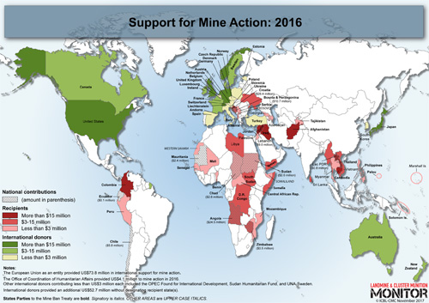
Additional Resources
Country Profiles
Factsheets and Reports
Maps (static and interactive)
Visit www.the-monitor.org
Email monitor2@icblmc.org
Tweet @MineMonitor @minefreeworld
Notes:
Landmine and Cluster Munition Monitor produces several research products including the annual Landmine Monitor and Cluster Munition Monitor reports, online country profile reports, as well as factsheets and special reports.
The ICBL and CMC websites are excellent resources for additional information and campaign activities. http://www.icbl.org/ and http://www.stopclustermunitions.org/
We extend our gratitude to Monitor contributors*.
Government of Australia
Government of France
Government of Germany
Government of Luxembourg
Government of Norway
Government of Sweden
Government of Switzerland
Government of the United States of America**
Holy See
UNICEF
UN Mine Action Service (UNMAS)
The Monitor’s supporters are in no way responsible for, and do not necessarily endorse, the material contained in this report. We also thank the donors who have contributed to the organizational members of the Monitoring and Research Committee and other participating organizations.
* List accurate as of November 2017.
** Specifically for research on mine action, support for mine action, casualties, and victim assistance.

