Slide 1
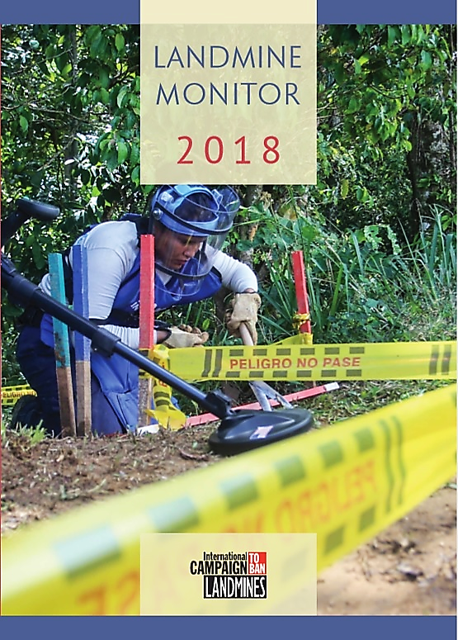
20th ANNUAL EDITION
Deminer Jeniffer Diaz, 22, at work in Vista Hermosa, Colombia
© J.M. Vargas/Humanity & Inclusion (HI), November 2017
Notes:
Pictured here is a female deminer Jeniffer Diaz conducting clearance in Colombia, a graphic representation of the hard work that goes into creating a mine-free world. First published in 1999, this annual Landmine Monitor is a milestone 20th edition and continuation of the precedent-setting civil society-based verification approach to monitoring global agreements, now employed in other humanitarian disarmament contexts.

Slide 2
Main Sections of the Report
Landmine Ban Policy
Contamination and Clearance
Casualties
Victim Assistance
Support for Mine Action
Notes:
Landmine Monitor 2018 provides a global overview of efforts in 2017, and into November 2018 where possible, to universalize and fully implement the 1997 Mine Ban Treaty, and more generally assess the international community’s response to the global landmine and explosive remnants of war problem. It covers developments in the areas of antipersonnel landmine use, production, stockpiling, mine action, casualties, victim assistance, and mine action funding.
This presentation generally follows the order of these sections, highlighting the Major Findings of the report.

Slide 3
Landmine Monitor 2018 - overview
Global ban endures with 2 new countries joining Mine Ban Treaty; landmines used by only one government force outside the Treaty—and by non-state actors in at least 8 countries.
Financial support for mine action at all-time high levels in 2017.
Civilian and child casualties remain high, many due to improvised mines; overall reported casualties saw a slight decrease in 2017 compared to 2016.
Clearance continues, however only a few countries are on track.
Notes:
A small number of states and non-state armed groups use antipersonnel mines, including improvised mines, which contributed to a still high number of casualties recorded in 2017.
Many countries continue to clear mine contamination, and international funding for mine action increased to a record high in 2017.
However, very few States Parties appear to be on track to meet clearance deadlines, and support to victims remains inadequate.

Slide 4
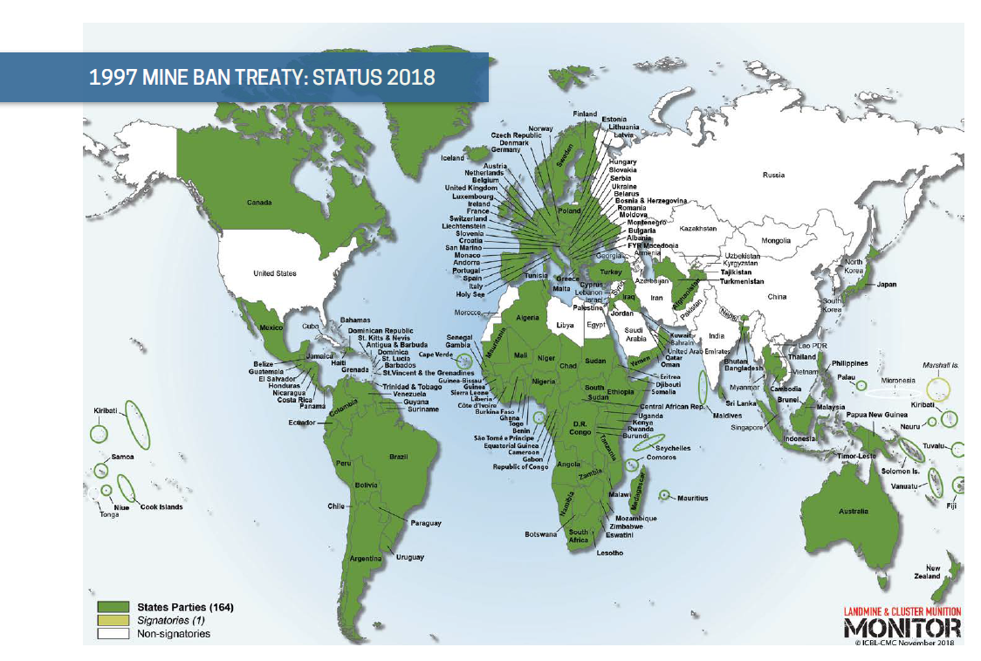
A total of 164 States Parties are implementing the treaty’s provisions now that Palestine and Sri Lanka acceded in December 2017.
The 33 countries that remain outside of the treaty are nonetheless abiding by its key provisions.
Notes:
As we approach twenty years since the Mine Ban Treaty entered into force, it continues to be a tremendous life-saving success.
Sri Lanka acceded on 13 December, while the State of Palestine acceded on 29 December.
One signatory—Marshall Islands—that has yet to ratify.

Slide 5
Landmine Use
Use of antipersonnel mines by states remains rare. No allegations of new use by States Parties between October 2017 – October 2018.
The government forces of Myanmar, a state not party to the treaty, used antipersonnel landmines in the past year.
The Monitor was unable to confirm any use of antipersonnel landmines by Syrian government forces.
Non-state armed groups used antipersonnel landmines, including improvised mines, in at least 8 countries: Afghanistan, Colombia, India, Myanmar, Nigeria, Pakistan, Thailand, and Yemen.
Likely also in Iraq and Syria (Islamic State).
Notes:
Antipersonnel mines have been used by government forces of Myanmar throughout the past 20 years, a state not party to the Mine Ban Treaty.
Forces of the Islamic State likely continued to use improvised landmines in Iraq and Syria, but the lack of access to affected areas by independent sources makes it difficult to confirm new use in the reporting period.
Landmine Monitor was unable to confirm allegations of new antipersonnel mine use by NSAGs in Cameroon, Iraq, Mali, Libya, Philippines, Tunisia, and Ukraine in the reporting period.

Slide 6
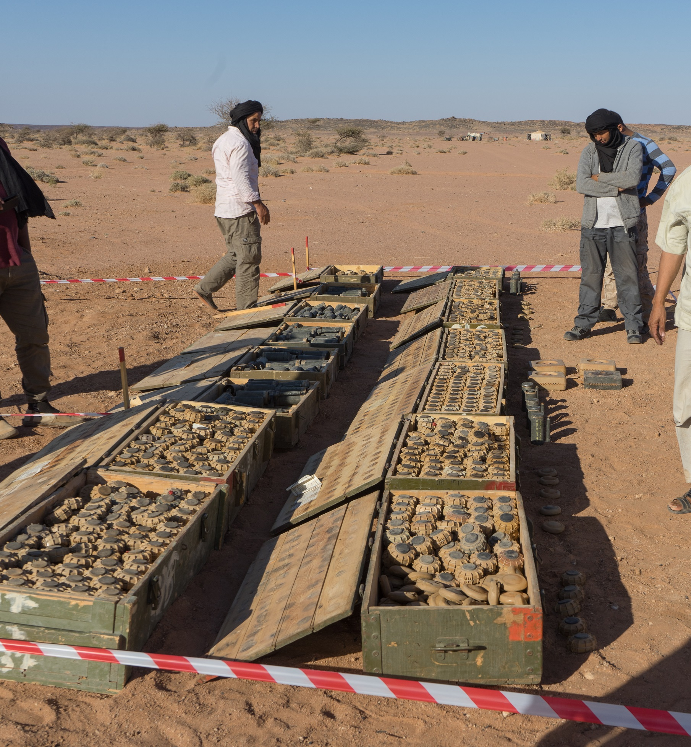
Stockpile Destruction, Production, Transfer
More than 500,000 stockpiled mines were destroyed in 2017.
Oman is expected to complete its stockpile destruction in February 2019.
91 states do not retain any mines.
41 states have ceased production, 11 remain listed as producers
At least nine states not party to the Treaty have formal moratoriums on the export of antipersonnel mines
Stockpiled antipersonnel landmines being counted before their destruction in Western Sahara as part of the Polisario Front’s efforts under the Deed of Commitment.
© N. Sion/Geneva Call, May 2018
Notes:
States Parties to the Mine Ban Treaty have destroyed more than 54 million stockpiled antipersonnel mines.
The Monitor lists 11 states as landmine producers because they have yet to disavow future production, unchanged from the previous report: China, Cuba, India, Iran, Myanmar, North Korea, Pakistan, Russia, Singapore, South Korea, and Vietnam.
Those most likely to be actively producing are India, Myanmar, Pakistan, and South Korea.
At least nine states not party to the ban have formal moratoriums on the export of antipersonnel mines: China, India, Israel, Kazakhstan, Pakistan, Russia, Singapore, South Korea, and the US.

Slide 7
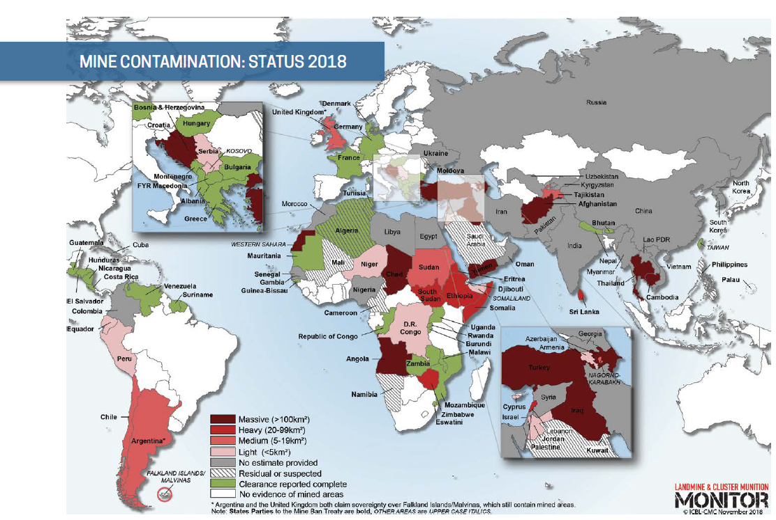
60 states and areas have an identified threat of antipersonnel mine contamination:
34 States Parties
22 states not party
four other areas
Notes:
The Monitor acknowledges the contributions of the Mine Action Review (www. mineactionreview.org), which has conducted the primary mine action research in 2018 and shared all its country-level landmine reports (from Clearing the Mines 2018) and country-level cluster munition reports (from Clearing Cluster Munition Remnants 2018) with the Monitor. The Monitor is responsible for the findings presented online and in its print publication.
In addition to the 60 countries and areas with mine contamination, an additional 10 States Parties and one non-state party has residual or suspected contamination.

Slide 8
Contamination
Massive antipersonnel mine contamination (>100 km² per country) is believed to exist in Afghanistan, Angola, Azerbaijan, Bosnia and Herzegovina, Cambodia, Chad, Croatia, Iraq, Thailand, Turkey, Yemen and Western Sahara.
There was new contamination in 2017 and/or 2018 in States Parties: Afghanistan, Colombia, Iraq, Nigeria, and Yemen; and in states not party: India, Myanmar, Pakistan, Syria, and Thailand.
Notes:
The global picture did not change considerably in 2017, nonetheless, some states continued to improve their understanding of the extent of contamination in 2017 using land release methodologies to cancel suspected areas by non-technical survey and to reduce confirmed hazardous area through technical survey.

Slide 9
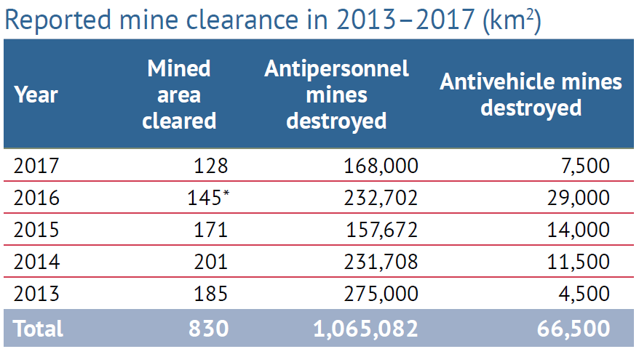
Clearance
Mauritania completed clearance in 2017.
About 128 km² reported cleared, 168,000 antipersonnel mines were destroyed in 2017.
Only 4 State Parties are on track to meet their clearance deadlines.
Limited demining occurred along the DMZ in October 2018
Notes:
Mauritania completed clearance in December 2017.
Mozambique, which had declared completion in 2015 but subsequently found previously unidentified antipersonnel mine contamination in 2016 and 2017, completed clearance in May 2017.
Twenty-nine States Parties, one state not party, and one other area have completed clearance of all mined areas on their territory since the Mine Ban Treaty entered into force in 1999.
In 2017, more than 168,000 antipersonnel mines and some 7,500 antivehicle mines were destroyed. This represented a significant decrease from the 2016 results. However, this is an underestimation as some actors do not systematically report clearance results.
The largest total clearance of mined areas in 2017 was achieved in Afghanistan, Croatia, Iraq, and Cambodia (the same countries as 2016), which together accounted for more than 80% of recorded clearance.
Over the past five years (2013–2017), approximately 830km² of mined areas have been cleared. Some 1.1 million antipersonnel mines and more than 66,000 antivehicle mines have been destroyed in the context of mine and battle area clearance.
Although most countries are not on track with their respective Article 5 clearance deadlines, the majority should reach the 2025 clearance goal, with sufficient funds and commitment, and where security conditions permit.
Seven States Parties requested extended deadlines for approval at the Seventeenth Meeting of States Parties in November 2018: BiH, Croatia, Cyprus, Serbia, Sudan, Ukraine, and the United Kingdom.

Slide 10
Casualties
The Monitor recorded 7,239 mine/ERW casualties, of which at least 2,793 people were killed, in 2017.
This marks a slight decrease from 2016, but the third year in a row of exceptionally high annual casualties.
The vast majority of recorded landmine/ERW casualties were civilians (87%) where their status was known, an even higher ratio than in recent years.
Notes:
2017 was the third year in a row with exceptionally high numbers of recorded casualties due to landmines and explosive remnants of war (ERW)—including improvised types that act as antipersonnel mines (also called improvised mines), cluster munition remnants, and other ERW.
The casualty database for Landmine Monitor Report 2018 includes an updated total of 9,437 casualties for 2016 (2,472 killed, 6,937 injured, and 28 unknown). At the time of the publication of Landmine Monitor Report 2017, 8,605 casualties had been recorded for 2016 (2,089 killed, 6,491 injured, and 25 unknown).
Recent years civilians have accounted for 78% of casualties, where status was known

Slide 11
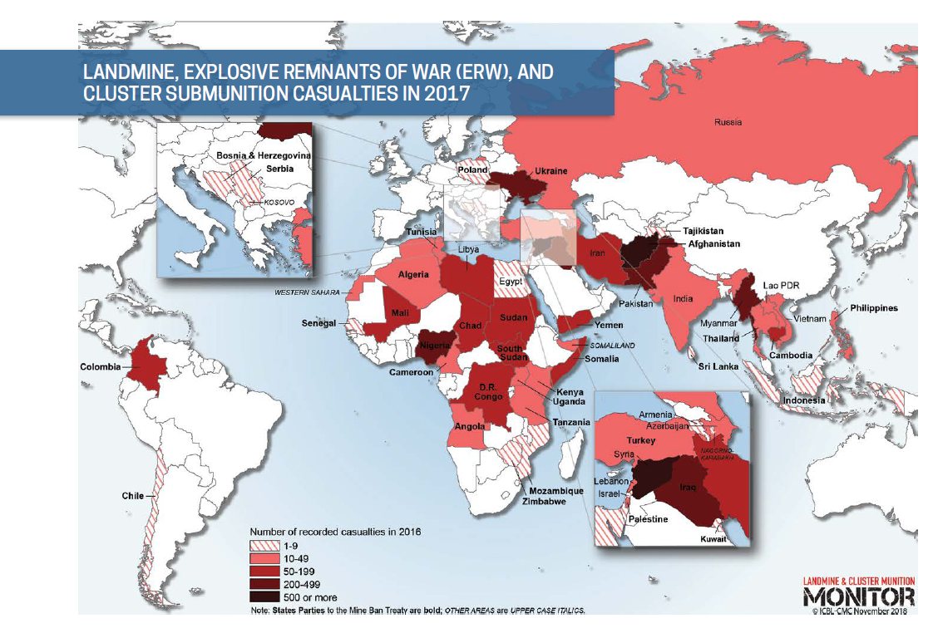
Casualties were identified in 49 states and four other areas in 2017, of which 35 are States Parties to the Mine Ban Treaty.

Slide 12
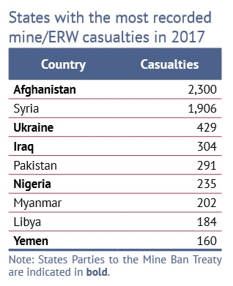
The continuing high total was influenced by casualties recorded in countries facing armed conflict and large-scale violence, particularly Afghanistan and Syria.
For a second year in a row, the highest numbers in Monitor history were recorded for annual casualties caused by improvised mines (2,716) and for child casualties (2,452).
Children accounted for 47% of all civilians casualties where the age was known
Notes:
In 2017, children accounted for 47% of all civilian casualties where the age was known, an increase of 5 percentage points from the 2016 annual total.
Women and girls made up 13% of all casualties where the sex was known.

Slide 13
Victim Assistance
States Parties with significant numbers of mine victims suffered from a lack of adequate resources to fulfill the commitments of the 2014–2019 Maputo Action Plan.
Some efforts to improve the quality and quantity of health and physical rehabilitation programs for survivors were undertaken.
2017–2018 saw near-stagnation in other core assistance services for mine/ERW victims.
New States Parties Palestine and Sri Lanka will likely need assistance to effectively meet victims’ needs.
Notes:
Survivor networks also struggled to maintain their operations as they faced decreased resources.
Services remained largely centralized, preventing many mine/ERW survivors who live in remote and rural areas from accessing those services. Shortages of raw materials and financial resources were an obstacle to improvements in the physical rehabilitation sector in several countries.
Only 14 of the 33 States Parties had victim assistance or relevant disability plans in place to address recognized needs and gaps in assistance.
Approximately two-thirds of the States Parties had active coordination mechanisms, and survivors’ representatives participated in 18 of the coordinating processes among those 21 States Parties. State initiatives for capacity-building toward increased participation of mine victims were almost never reported.
Significant gaps remain in access to employment, training, and other income-generation support activities in many of the States Parties where opportunities for livelihoods were most needed.

Slide 14
Support for Mine Action: overview
Donors and affected states contributed approximately US$771.5 million in combined international and national support for mine action in 2017, an increase of $203.6 million (36%) compared to 2016.
Donors contributed $673.2 million in international support for mine action to 38 states and three other areas, and increase of $190.3 million.
Highest level of international support ever recorded by the Monitor
10 affected states reported providing $98.3 million in national support for their own mine action programs, an increase of $13.3 million.
Notes:
The $771.5 million represents the highest combined nominal total of international and national mine action funding ever reported in Monitor data, going back to 1996. Note: adjusted for inflation, it is 2nd to 2012.
The international support level is the highest ever, even adjusting for inflation. It is too early to tell whether 2018 will also be at such a high level.
While the $98.3 million in identified national support is an increase compared to 2016, it is still much lower than in three years prior to 2016. See next slide.

Slide 15
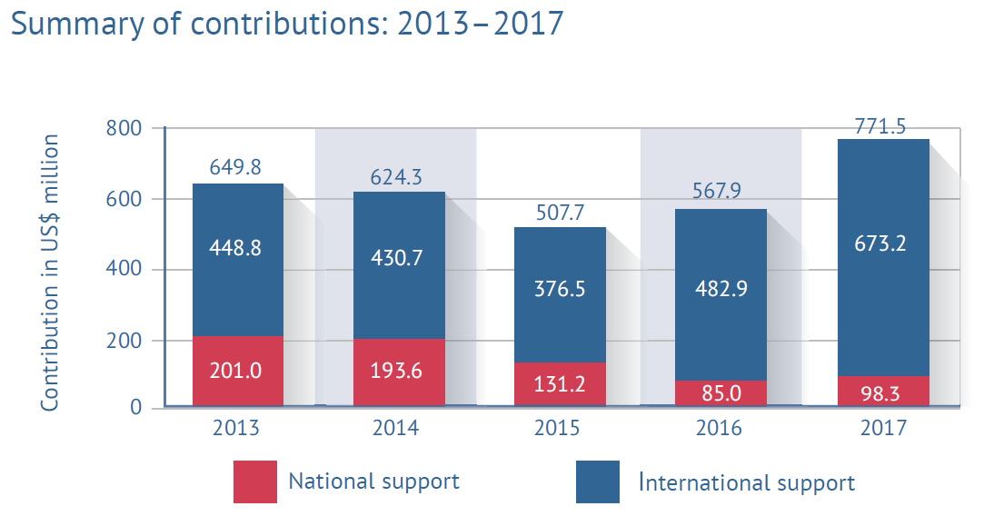
Notes:
The top five mine action donors—the United States (US), Germany, the European Union (EU), Norway, and Japan—contributed 79% of all international funding, with a combined total of $435.4 million.
The record 2017 total was primarily the result of massive increases in the contributions of the US ($309.0 million total, a $156.6 million increase) and Germany ($84.4 million total, a $47.1 million increase).
Mine action in five states—Iraq, Syria, Colombia, Afghanistan, and Lao PDR—received $435.4 million, or 65% of all international support in 2017.
The largest increases were for activities in Iraq and Syria, receiving respectively $120 million ($207.0 million total) and $70.8 million ($89.4 million total) more than in 2016.
Donor support explicitly dedicated to victim assistance remains low and difficult to track, representing only 2% of identifiable international support in 2017.

Slide 16
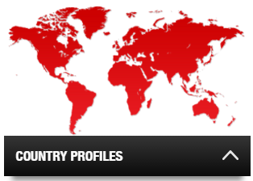
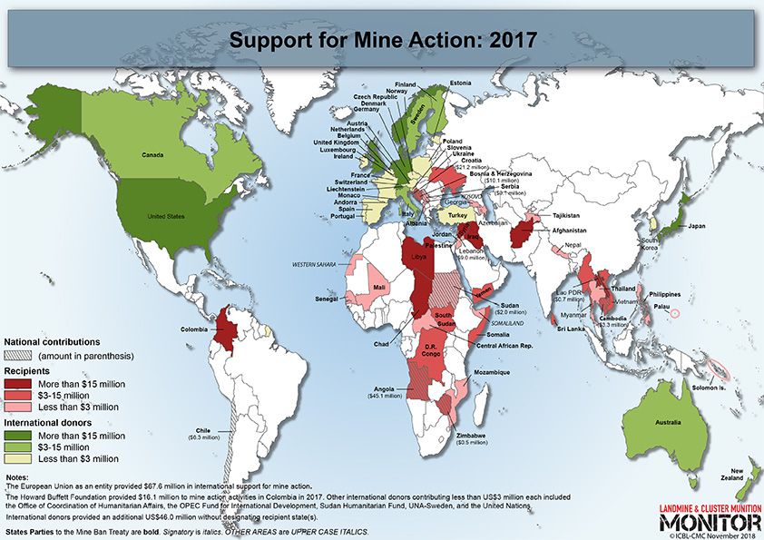
Additional Resources
Country Profiles
Factsheets and Reports
Maps
Visit www.the-monitor.org
Email monitor2@icblmc.org
Tweet @MineMonitor @minefreeworld
Notes:
Landmine and Cluster Munition Monitor produces several research products including the annual Landmine Monitor and Cluster Munition Monitor reports, online country profile reports, as well as factsheets and special reports.
The ICBL and CMC websites are excellent resources for additional information and campaign activities. http://www.icbl.org/ and http://www.stopclustermunitions.org/
We extend our gratitude to Monitor contributors*.
Government of Australia
Government of Austria
Government of Belgium
Government of France
Government of Germany
Government of Luxembourg
Government of Norway
Government of Sweden
Government of Switzerland
Government of the United States of America**
UNICEF
The Monitor’s supporters are in no way responsible for, and do not necessarily endorse, the material contained in this report. We also thank the donors who have contributed to the organizational members of the Monitoring and Research Committee and other participating organizations.
* List accurate as of November 2018.
** Specifically for research on mine action, support for mine action, casualties, and victim assistance.

