Slide 1
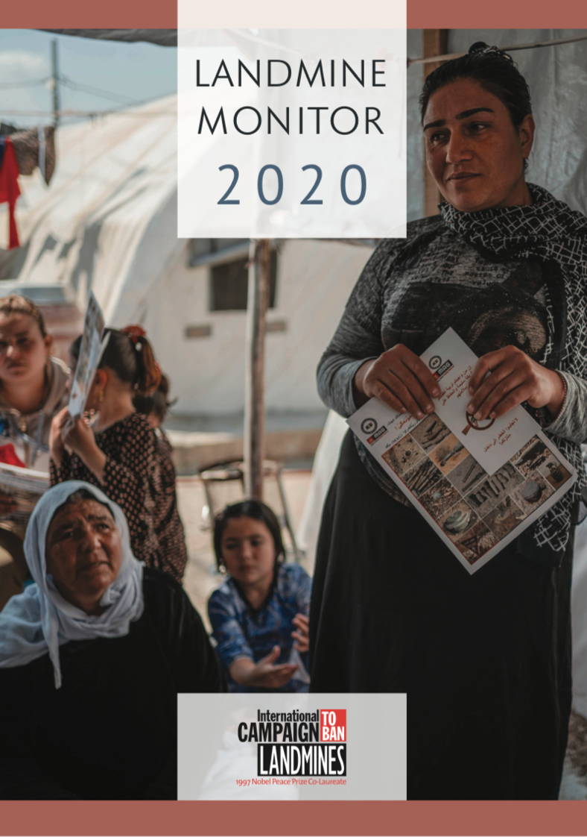

Press Launch
-------------------------
Landmine Monitor 2020
Thursday, 12 November
10:00 CET

Slide 2
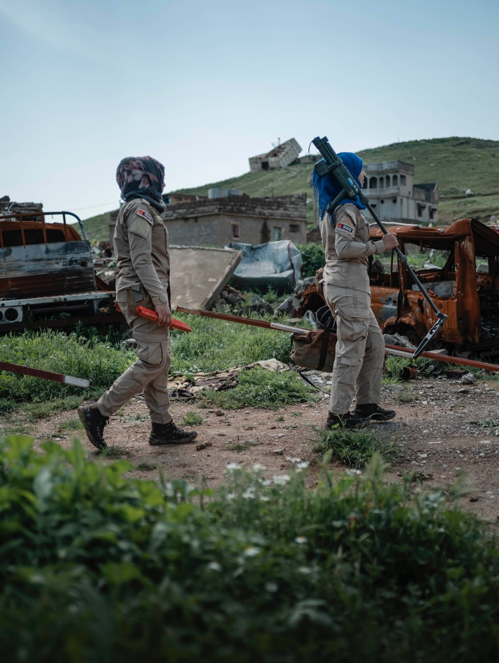

Landmine Monitor 2020
Press Launch
Host
Renata Dwan, UNIDIR Director
Ban Policy
Steve Goose, Arms Division Director, HRW
Impact (casualties and victim assistance)
Loren Persi, Editor
Impact (contamination, clearance, risk education) Ruth Bottomley, Editor
Support
Marion Loddo, Monitor Editorial Manager
Deminers head to work in Tal Afar, Iraq
© Sean Sutton/MAG, 2019

Slide 3
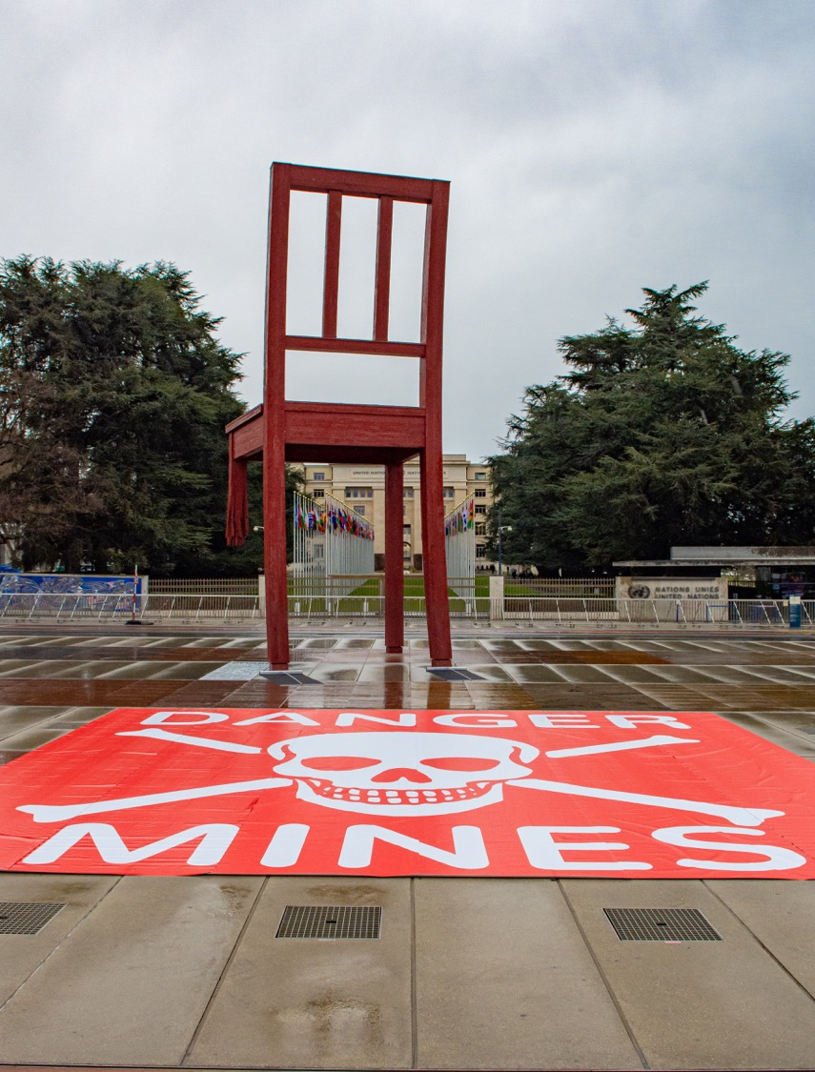
Landmine Monitor 2020
Status & Universalization
164 States Parties to the Mine Ban Treaty; the Marshall Islands is the last signatory yet to ratify.
US new landmine policy reversed previous directive banning production and limiting use of antipersonnel mines.
At least 70 non-state armed groups (NSAGs) have committed to halt using antipersonnel mines since 1997.
Broken Chair in Geneva, symbol of the campaign against landmines.
© HI, 2020

Slide 4
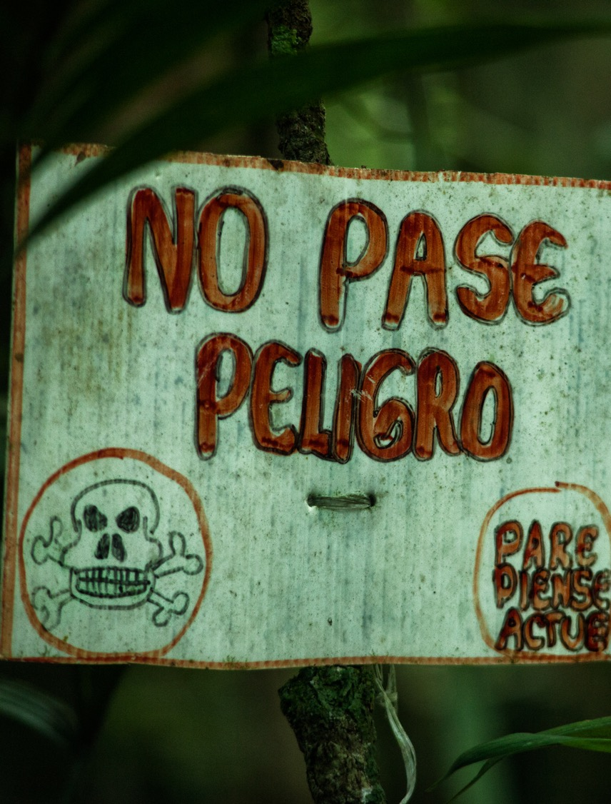
Landmine Monitor 2020
Use
From mid-2019–October 2020, confirmed new use by the government forces of Myanmar (state not party).
NSAGs use in at least six countries: Afghanistan, Colombia, India, Libya, Myanmar, and Pakistan.
As yet, unconfirmed allegations of new mine use by NSAGs in a dozen countries: Burkina Faso, Cameroon, Chad, Egypt, Mali, Niger, Nigeria, the Philippines, Somalia, Syria, Tunisia, Turkey, and Yemen.
Handmade marking sign to inform the community of the presence of landmines in Colombia.
© Luis Ayala/CCCM, 2019

Slide 5
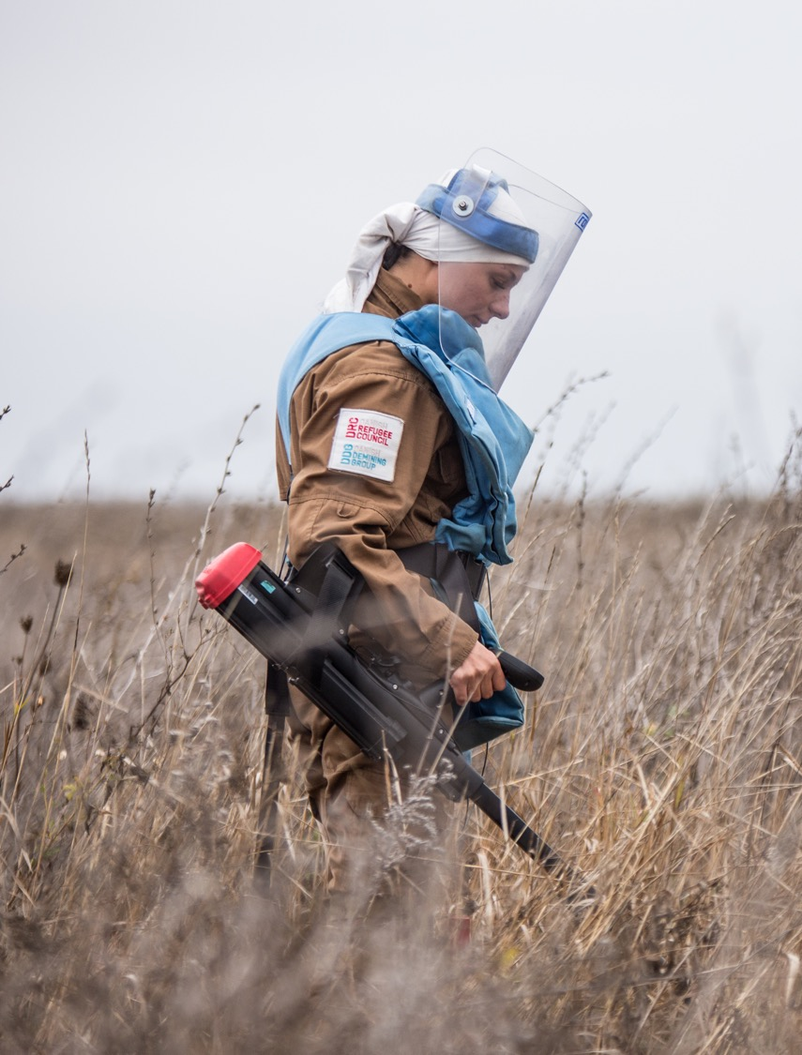
Landmine Monitor 2020
Stockpiles and Production
States Parties have destroyed more than 55 million stockpiled antipersonnel mines, incl. 260,000+ in 2019.
In 1999, all states stockpiled about 160 million antipersonnel mines. Today, global total could be approx. 45 million.
The Monitor lists 12 states as landmine producers: China, Cuba, India, Iran, Myanmar, North Korea, Pakistan, Russia, Singapore, South Korea, the US, and Vietnam. [In red=likely to be actively producing.]
NSAGs produced improvised landmines in: Afghanistan, Colombia, Myanmar, Nigeria, Pakistan, Tunisia, and Yemen.
Woman deminer searches a mine-contaminated agricultural field in Ukraine.
© Oleksandr Batushnvak/DDG, 2019

Slide 6
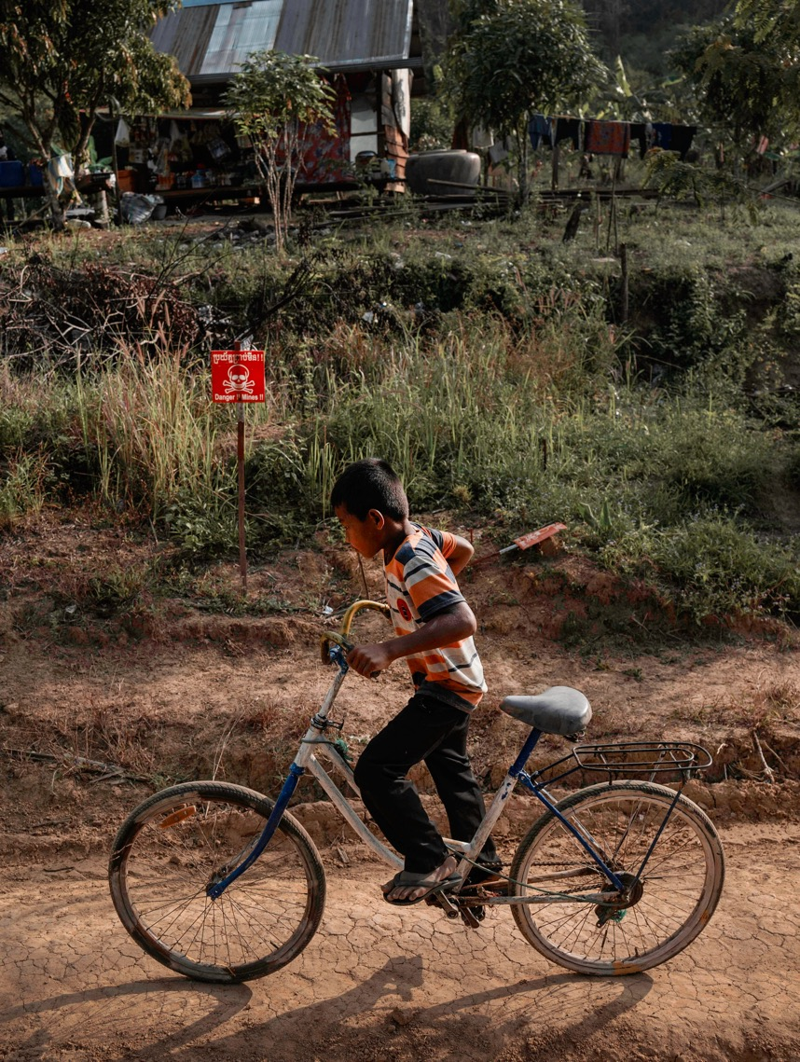
Landmine Monitor 2020
Casualties
2019, the fifth year in a row with exceptionally high numbers of recorded casualties.
Civilians represented 80% of all mine/ERW casualties where their status was known.
Children accounted for 43% of all civilian casualties where the age was known.
Men and boys represented 85% of all casualties for which the sex was known.
Monitor recorded 5,554 mine/ERW casualties in 2019: 2,170 killed; 3,357 injured; 27 casualties unknown.
Improvised mines caused most casualties with at least 2,994 recorded.
10-year old boy riding his bicycle past a suspected minefield where he libes in Cambodia.
© Sean Sutton/MAG, 2019

Slide 7
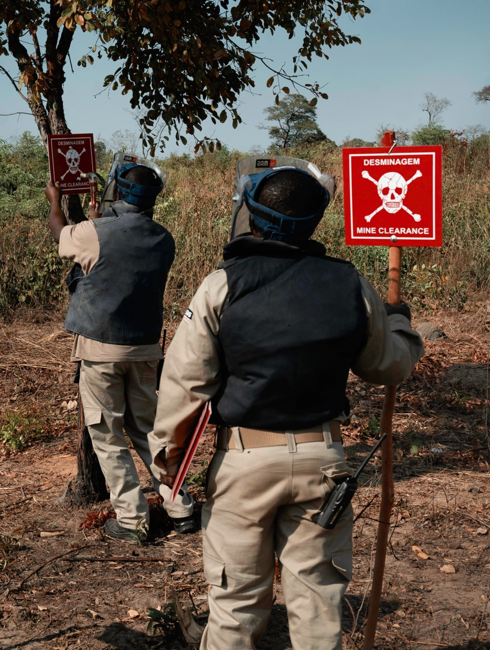
Landmine Monitor 2020
Contamination
60 states and areas contaminated by mines: 33 States Parties, 22 states not party, 5 areas.
3 State Parties need to clarify the extent of residual contamination and 5 State Parties need to provide informantion on suspected or known contamination by improvised mines.
Mauritania reported finding new contamination in 2019.
Massive mine contamination (+100km²) believed to exist in 10 States Parties: Afghanistan, Bosnia and Herzegovina, Cambodia, Croatia, Ethiopia, Iraq, Thailand, Turkey, Ukraine, and Yemen.
A MAG team marking off a known dangerous area in Angola
© Sean Sutton/MAG, 2019

Slide 8
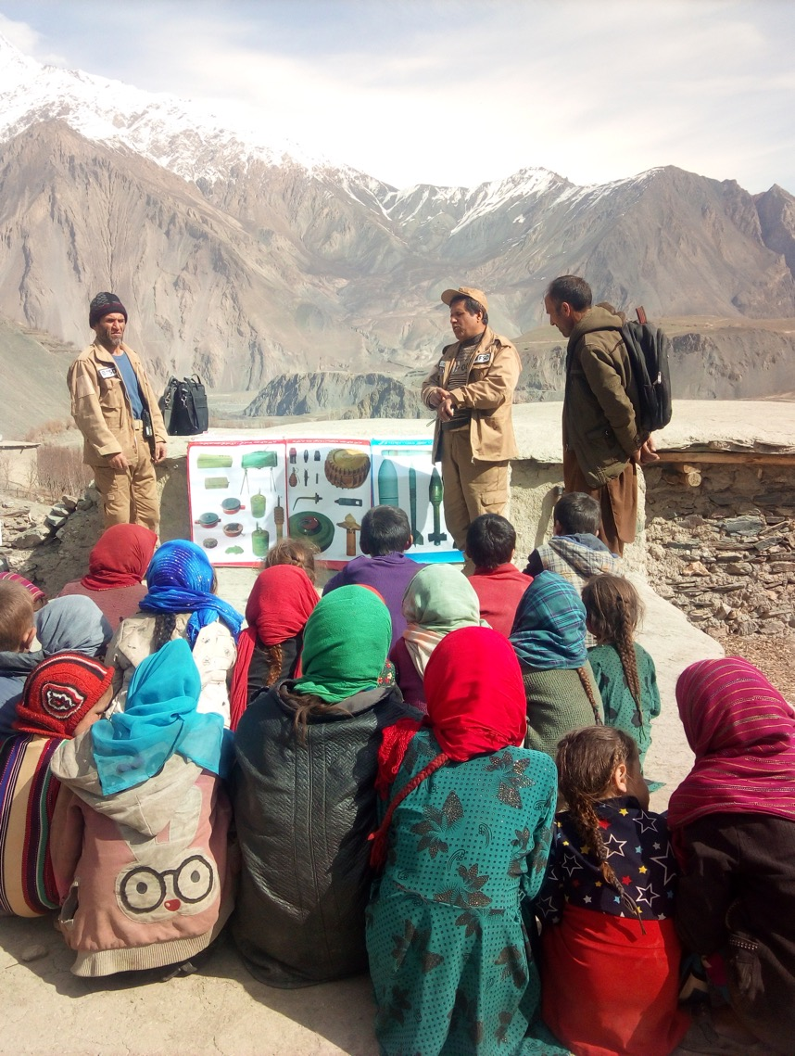
Landmine Monitor 2020
Risk Education
2019 marks a positive turning point for risk education.
The OAP includes a distinct set of actions for risk education.
Establishment of an international advisory group to help guide efforts and strengthen progress.
28 States Parties provided risk education to affected populations in 2019.
Risk groups:
  Adult men = primary risk group;
  Children = key risk group (mostly from ERW);
  Women and girls = key role in promoting safe behavior among their families and communities.
Children are educated about the risk of mines and other ERW in Afghanistan.
© FSD, 2019

Slide 9
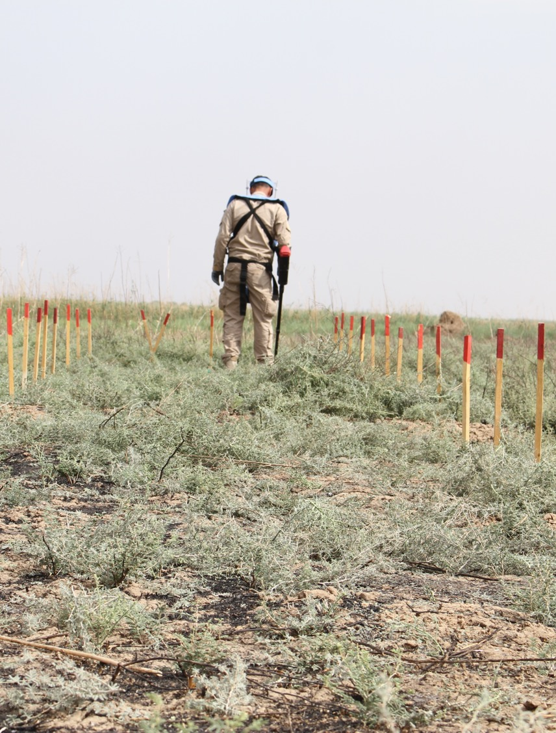
Landmine Monitor 2020
Clearance
At least 156km² reported cleared of in 2019, increase from estimated 146km² in 2018.
Afghanistan, Cambodia, Croatia, and Iraq have cleared more than 86% (similar to 2018).
30 States Parties, 1 state not party, 1 area have completed clearance of all mined areas since 1999.
Mine clearance was suspended in many countries and areas due to COVID-19 related restrictions in 2020.
Deminer at work in the surroundings of Bashir, Iraq.
© HI, 2019

Slide 10
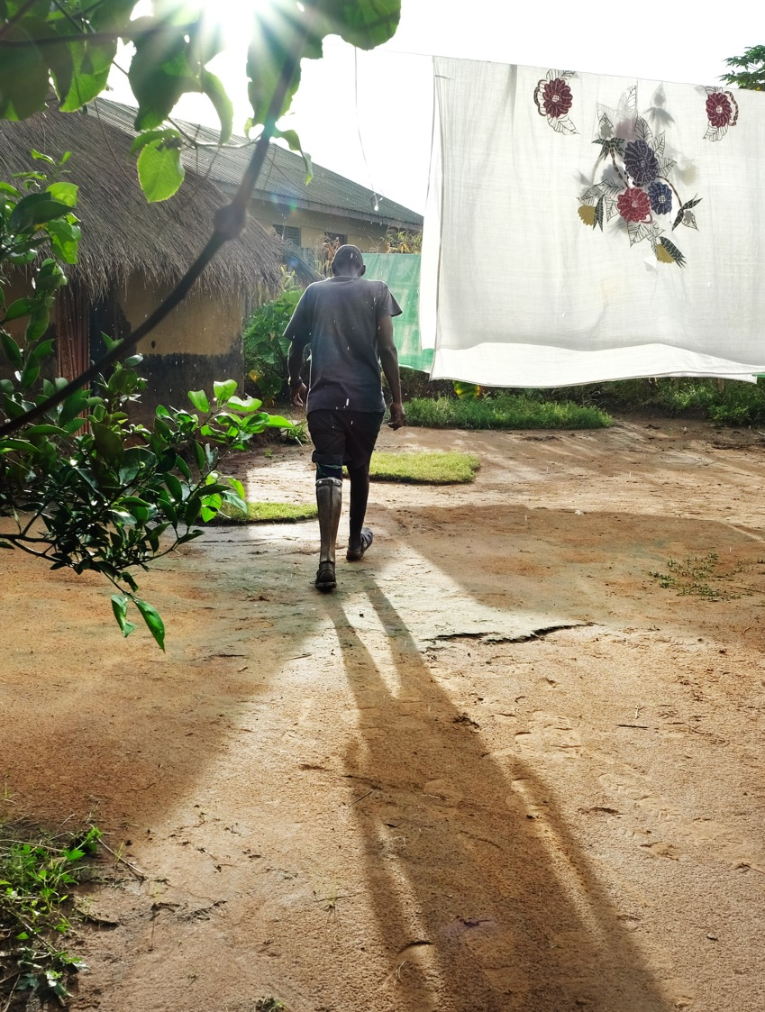
Landmine Monitor 2020
Victim Assistance
COVID-19 related restrictions prevented survivors to access services in a number of affected countries.
34 States Parties with significant numbers of mine victims.
Only 14 States Parties had victim assistance relevant plans in place.
Survivors participated in 18 of the coordinating processes in 21 States Parties.
Significant gaps in access to employment, training, and other income-generation support activities
Landmine survivor in his garden in South Sudan
© Dieter Telemans/HI, 2019

Slide 11
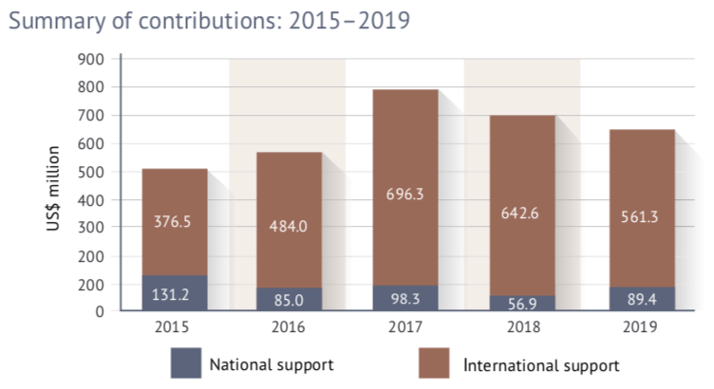
Landmine Monitor 2020
Support for Mine Action
Approx. US$650.7 million in combined support in 2019 – decrease of $48.8 million (7%) from 2018.
35 donors contributed $561.3 million in international support – decrease of $81.3 million (13%) from 2018.
  Top 5 mine action donors—US, EU, UK, Norway, Germany—contributed over $406 million (72%);
  5 states—Iraq, Afghanistan, Syria, Lao PDR, and Colombia—received $276.5 million (49%).
10 affected states provided $89.4 million in national support– increase of $32.5 million from 2017 (57%).

Slide 12
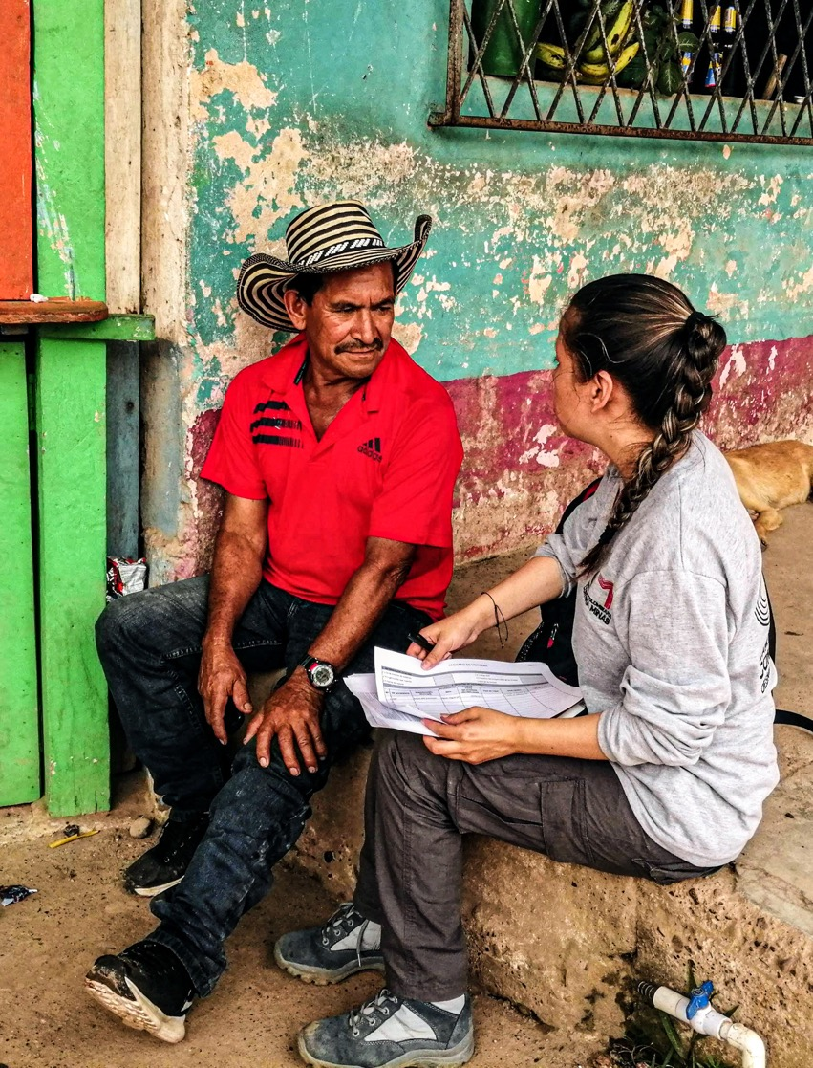
Landmine Monitor 2020
Press Launch
--------------------
www.the-monitor.org | @MineMonitor
monitor2@icblcmc.org
Landmine survivor receiving recovery and rehabilitation support from the Colombian Campaign to Ban Landmines.
© CCCM, 2019

