Slide 1
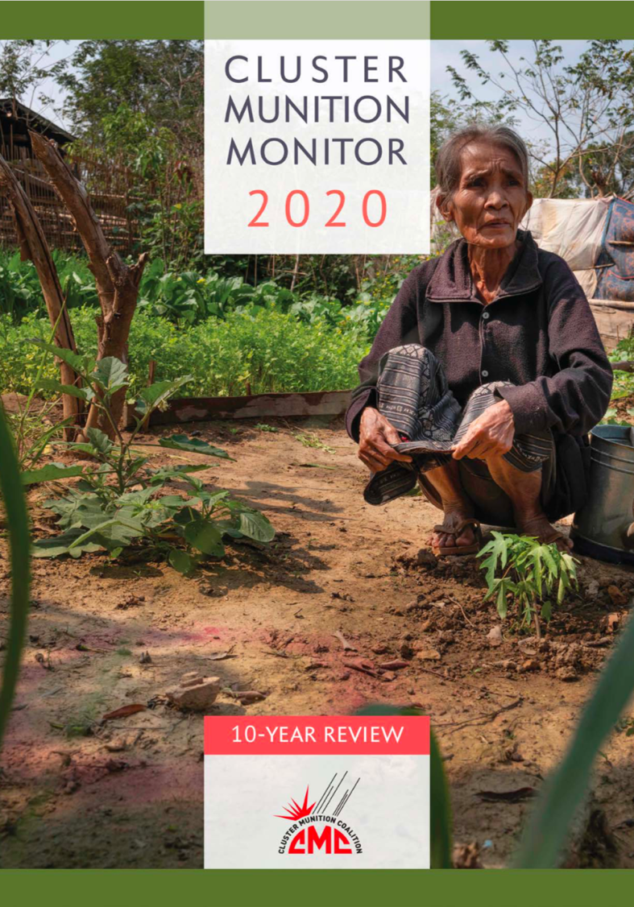
Cluster Munition Monitor 2020
------------------------------------------------------------
Launch on:
Wednesday, 25 November

Slide 2
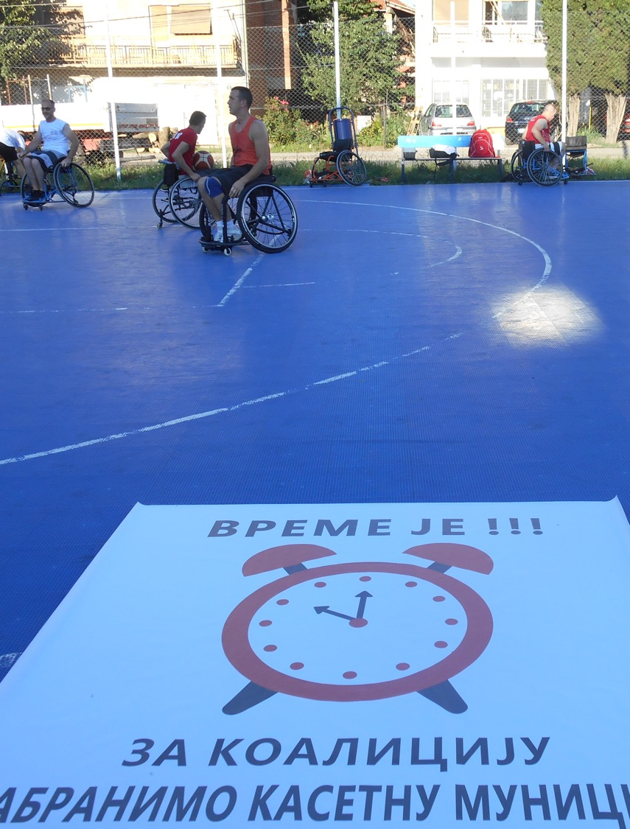
Cluster Munition Monitor 2020
Status & Universalization
Support for the norms established by CCM continues to grow.
110 States Parties
13 signatories.
Four new States Parties since last CMM report:
Accesions: Saint Lucia (Sep 2020); Niue (Aug 2020); the Maldives (Sept 2019);
Ratification: São Tomé and Príncipe (Jan 2020).
Wheelchair basketball game in Serbia to celebrate the 10-year anniversary of the CCM.
© Assistance Advocacy Access Serbia, 2020

Slide 3
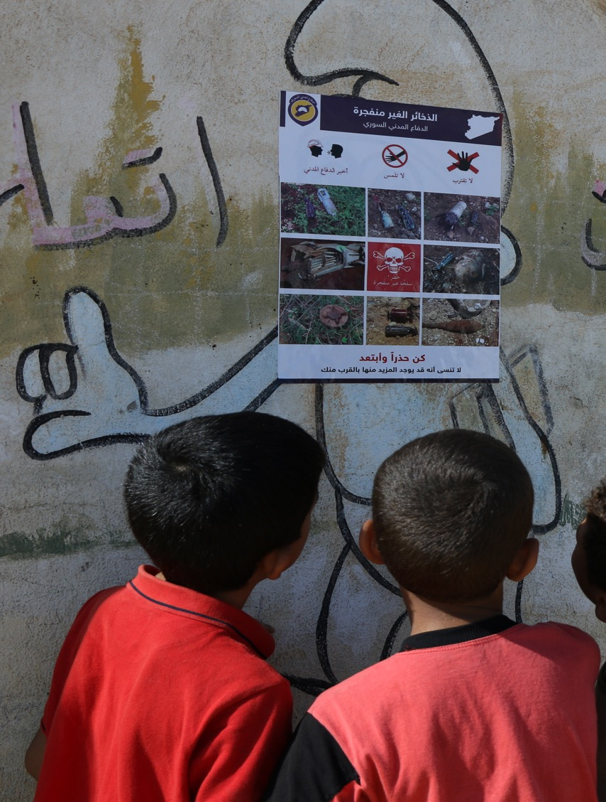
Cluster Munition Monitor 2020
Use
No reports or allegations of new use of cluster munitions by any States Parties since the adoption of CCM.
From Aug 2010–Jul 2020, confirmed new use in seven non-signatories: Cambodia, Libya, South Sudan, Sudan, Syria, Ukraine, and Yemen.
At least 686 cluster munition attacks in Syria since Jul. 2012 (continuous use since then).
As yet, unconfirmed allegations of new cluster munition use in: Yemen and region of Kashmir (Indian-Pakistan border).
Syrian boys read a mine risk education poster in an IDP camp.
© Michael Edwards/White Helmets, 2019

Slide 4
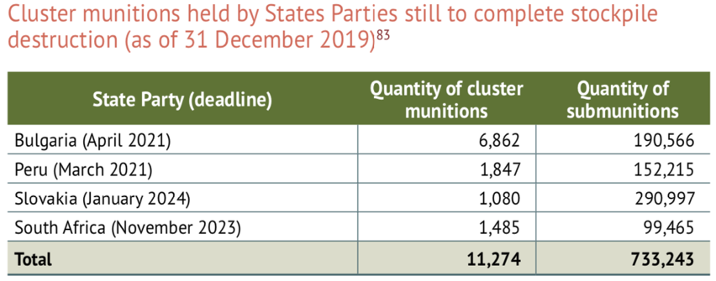
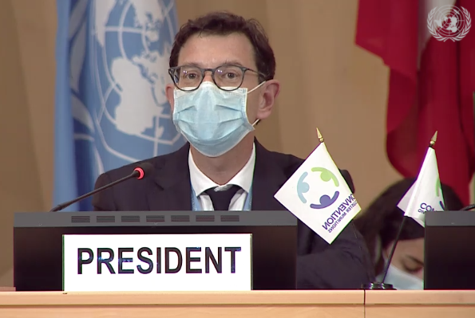
Cluster Munition Monitor 2020
Stockpile Destruction
At least 39 States have completed stockpile destruction (36 States Parties, 2 signatories, 1 non-signatory).
A total of 1.5 million cluster munitions containing +178 million submunitions have been destroyed.
This represents 99% of the total global cluster munition stocks declared.
In 2019, Bulgaria, Peru, and Slovakia destroyed 212 cluster munitions and +14,000 submunitions.
Stocks still to destroy in following States Parties: Bulgaria, Peru, Slovakia, and South Africa. Status unclear for Guinea and Guinea-Bissau.
Amb. Baumann leading discussion during preparatory meeting in Geneva.
© Mary Wareham, 2020

Slide 5
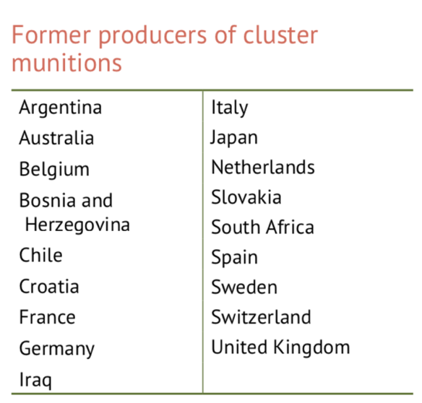
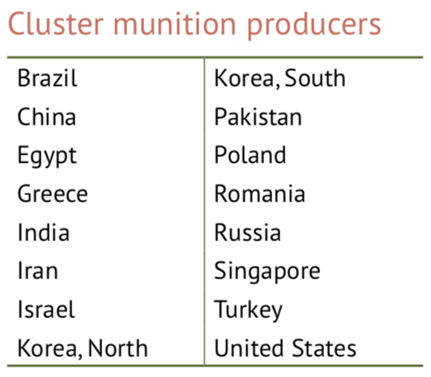
Cluster Munition Monitor 2020
Production
18 states have ceased production: 17 States Parties and 1 non-signatory (Argentina).
16 countries outside the convention produce cluster munitions. Incl. China and Russia which are actively researching and developing new types of cluster munitions in 2020

Slide 6
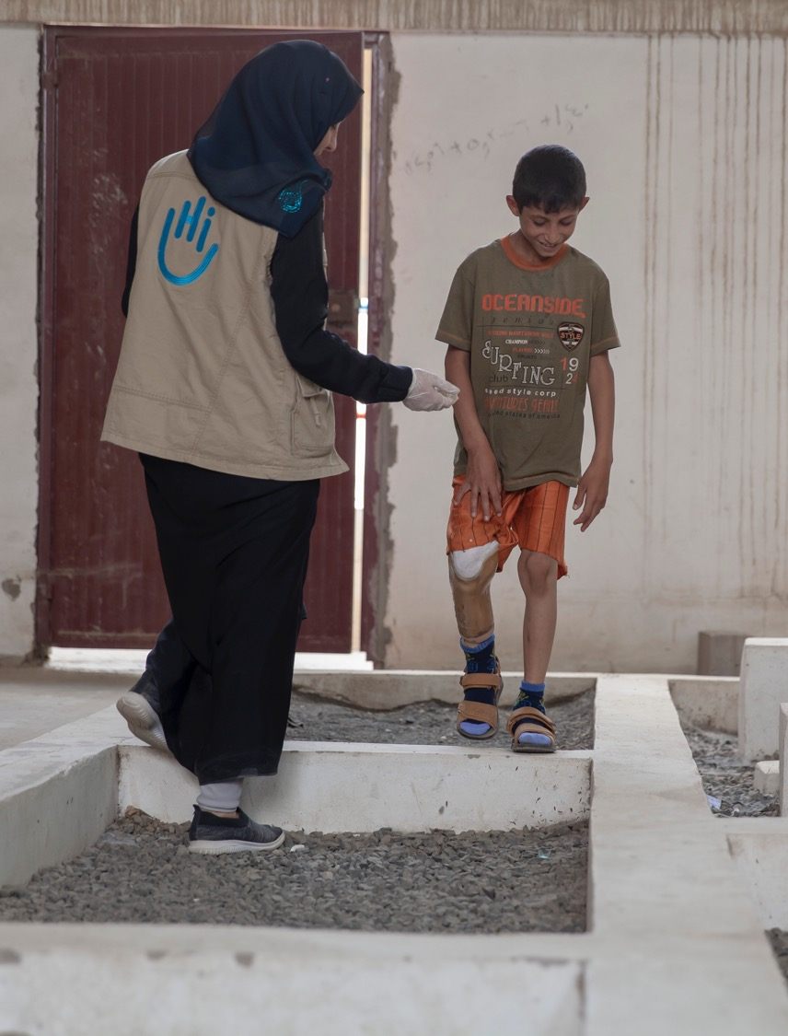
Cluster Munition Monitor 2020
Retention, Transparency, and National Legislation
Most States Parties do not retain cluster munitions and submunitions for training and development purposes. 13 States Parties—all from Europe, except Cameroon—are retaining cluster munitions for training and research purposes.
A total of 100 States Parties have submitted an initial transparency report as required by the convention, representing +90% of all States Parties for which the obligation currently applies.
32 States Parties have enacted national legislation, at least 20 are in the process of doing so, at least 43 have indicated existing laws are sufficient.
This 10-year old boy was injured during an airstrike near a market in Sanaa, Yemen.
© ISNA Agency/HI, 2019

Slide 7
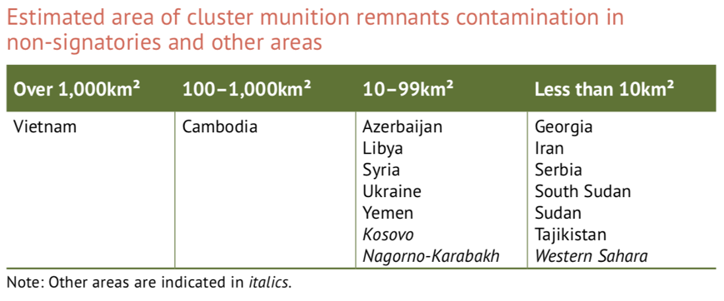
Cluster Munition Monitor 2020
Contamination
26 states and areas contaminated by CMR: 10 States Parties, 13 states not party, 3 areas.
Massive and large contamination (+100km²) believed to exist in 2 States Parties: Lao PDR (+1,000km²) and Iraq (+100km²).
New use since entry into force caused further contamination in Cambodia, Libya, South Sudan, Sudan, Syria, and Yemen; and new contamination in Ukraine.

Slide 8
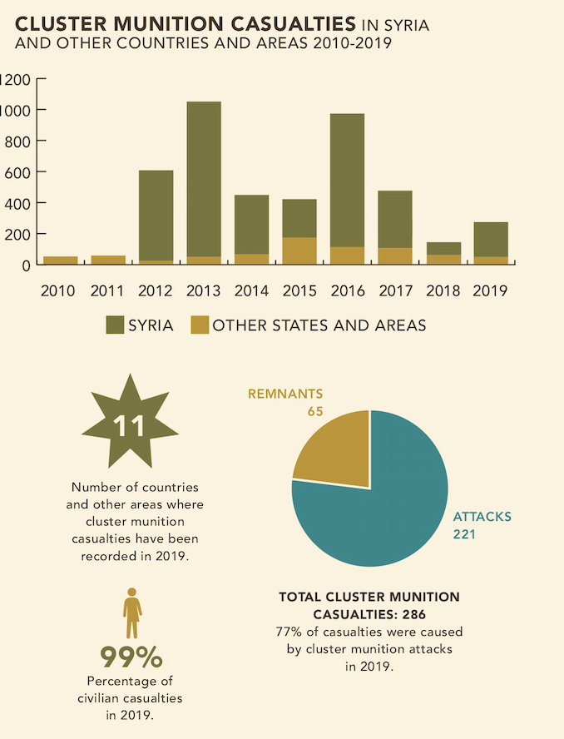
Cluster Munition Monitor 2020
Casualties
In 2010–2019: at least 4,315 cluster munition casualties; < 80% recorded in Syria.
Children accounted for 40% of all casualties.
Monitor recorded 286 cluster munition casualties in 2019; this is an increase from 2018 (149 casualties).
221 casualties recorded during attacks; in Syria and Libya.
65 casualties due to cluster munition remnants; in Afghanistan, Iraq, Lao PDR, Lebanon, Serbia, South Sudan, Syria, Yemen, and other areas Nagorno-Karabakh and Western Sahara.

Slide 9
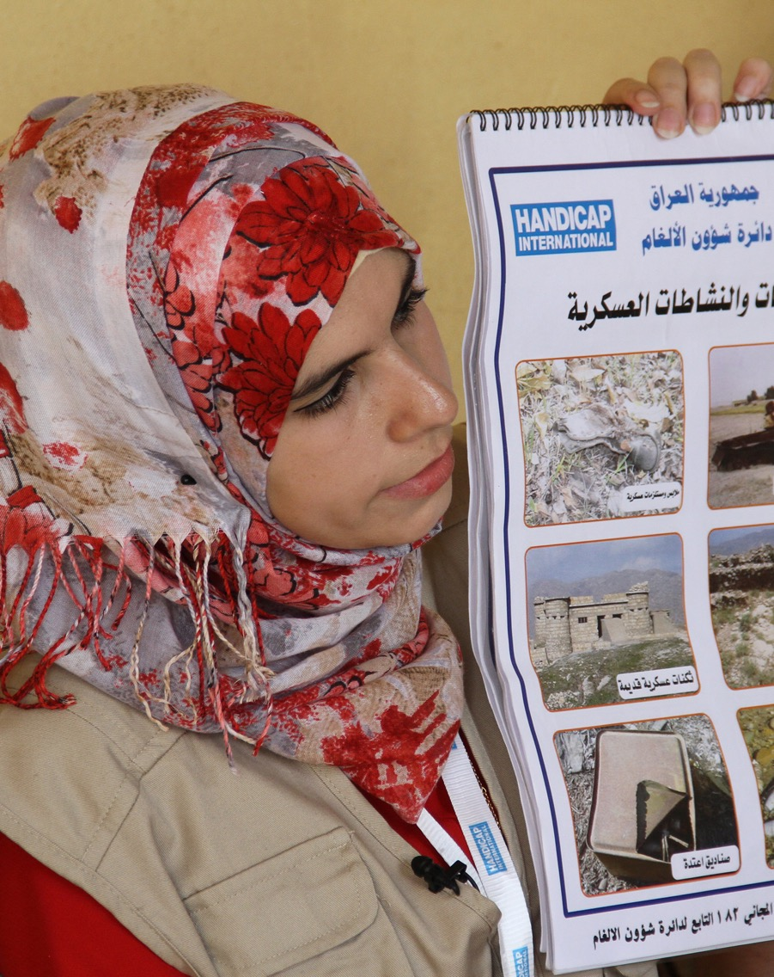
Cluster Munition Monitor 2020
Risk Education
Most of cluster munition contaminated States Parties have some provision of risk education.
Only Lao PDR has risk education directed predominantly to addressing risks associated with cluster munition remnants.
10 States Parties had risk education coordination institutions in 2019.
Only Iraq and Lao PDR provided beneficiary numbers disaggregated by age and sex.
Risk education session in Iraq.
© Waleed Khaled/HI, 2019

Slide 10
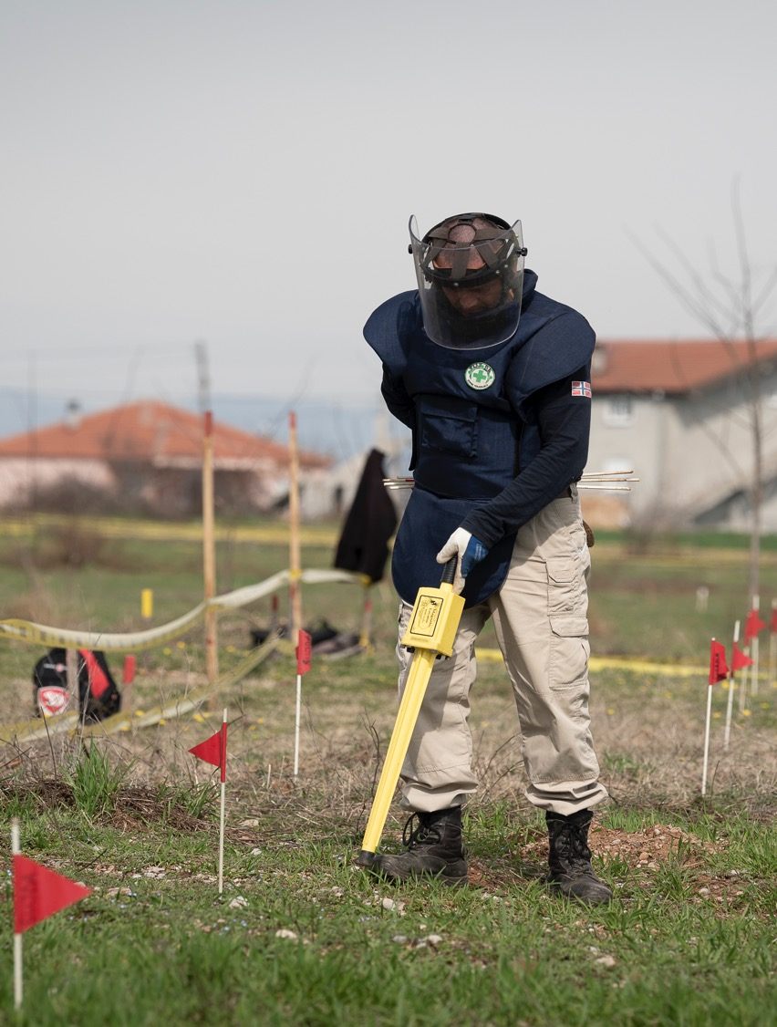
Cluster Munition Monitor 2020
Clearance
At least 82km² reported cleared and +96,500 submunitions destroyed in 2019.
Since 2010: six States Parties completed clearance; most recently Croatia and Montenegro in July 2020.
Five States Parties requested clearance deadline extensions: Germany and Lao PDR (granted in 2019); and Bosnia and Herzegovina, Chile, and Lebanon (to be considered during 2nd RevCon).
Deminer at around Podgorica Airport in Montenegro. © Kristian Skeie/NPA, 2020

Slide 11
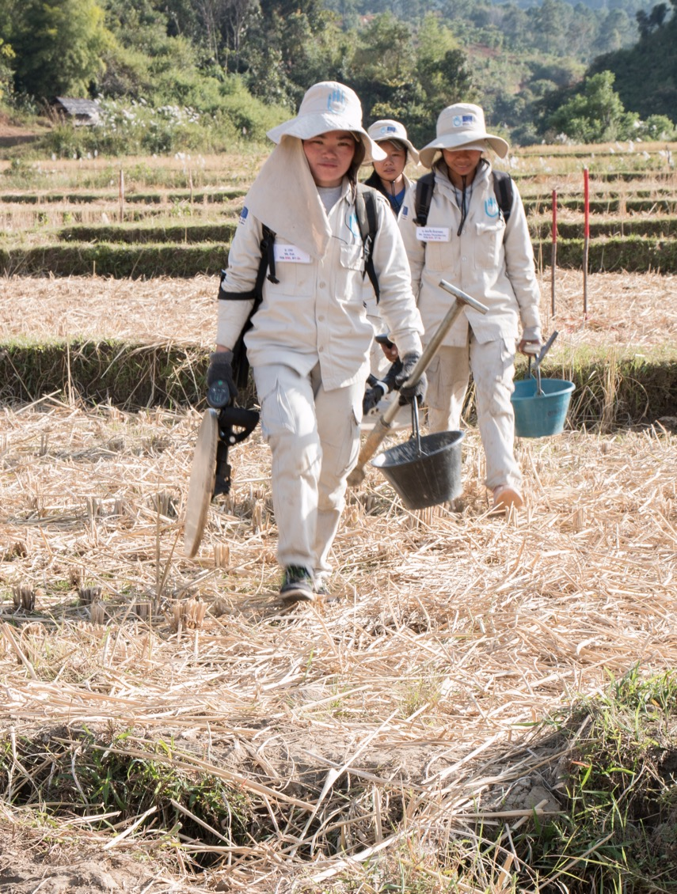
Cluster Munition Monitor 2020
Victim Assistance
Some assistance existed in all of the 14 States Parties with cluster munitions victims.
However, funding shortages affected improvement and implementation of assistance including services in the area of access to work, employment and livelihoods.
As of the end of 2019: 6 of the 14 States Parties had current planning in place for victim assistance.
All but one had a designated victim assistance focal point.
HI all-women demining team in Lao PDR.
© N. Lozano Juez/HI, 2019

Slide 12
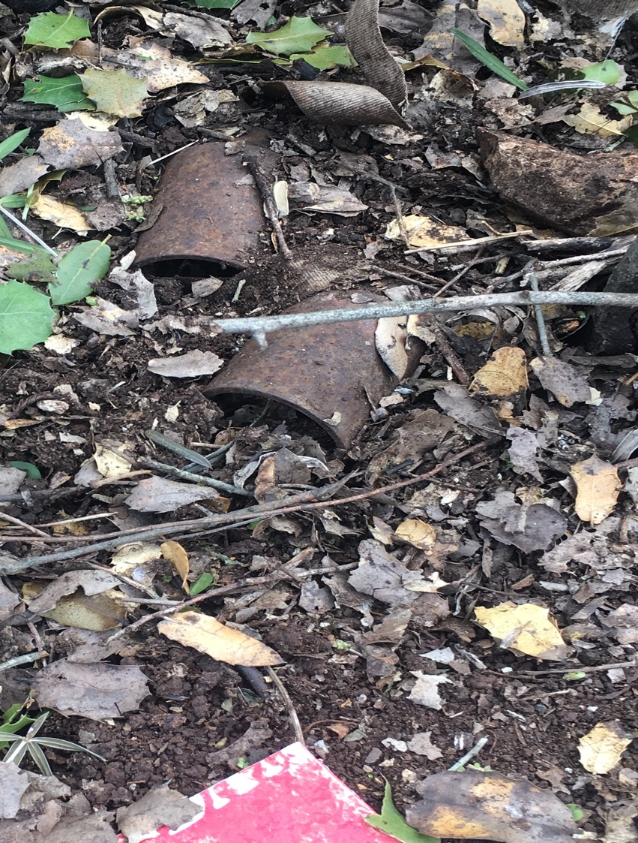
Cluster Munition Monitor 2020
-------------------------------------------------
www.the-monitor.org | @MineMonitor
monitor2@icblcmc.org
Cluster munition remnants photographed in Lebanon.
© CAR, 2019

